Slide 1

(RE)POSITIONED
FOR SUCCESS
Kent Gibson, BOMA Fellow
Chair and CEO of BOMA International
President of
Capstone Property Management, L.C.
Notes:
Hello! [Opening remarks about being happy to join everyone in Russia, thanking appropriate people for the invitation to speak, etc.] Today, I would like to discuss with you strategies that can help you find success in the commercial real estate marketplace. While I come from the United States, these strategies are universal and can be applied to properties around the globe.
First, I’ll take you through how I repositioned one of my assets a few years ago to increase occupant area, rentable area, NOI and building value—and how repositioning your assets can help you do the same.
Next, I’ll share some information about using building designations—specifically the BOMA 360 designation—to help your property stand out from the crowd, increase operational efficiency, gain and retain tenants and boost rental income.
Lastly, I’ll walk you through four case studies showing how four different commercial properties used the BOMA 360 designation to their advantage.

Slide 2
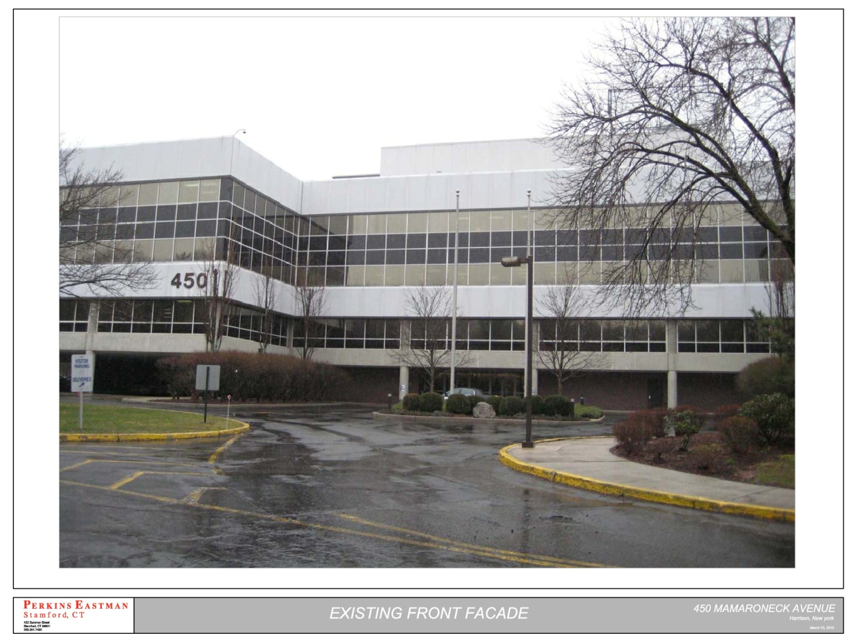
Repositioning an Office Building

Slide 3
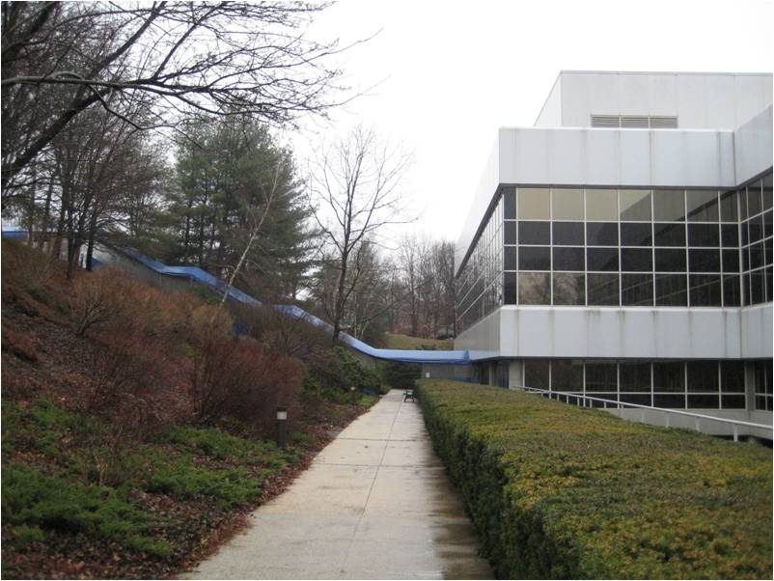
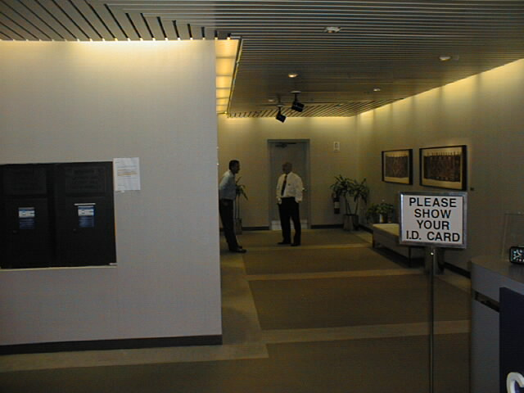
What does the building look like?
Rear Entrance
Lobby

Slide 4
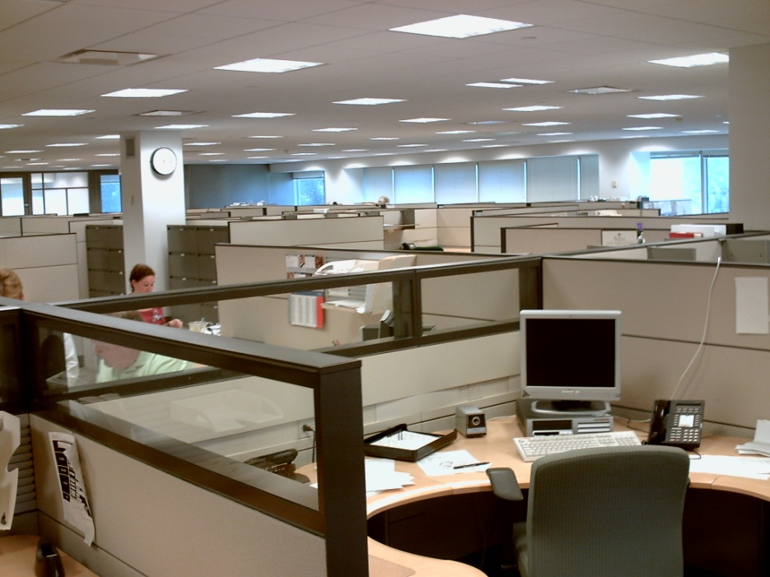
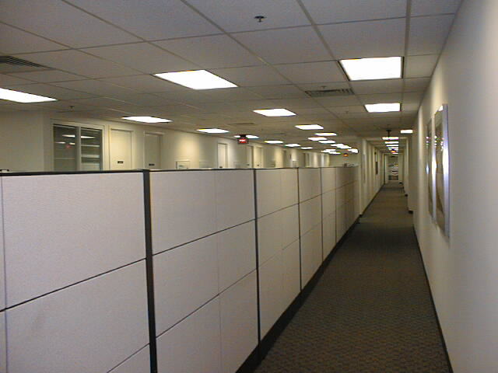
Interior of the Office Space
Tenant Space Cubicles
Tenant Space Hallway

Slide 5
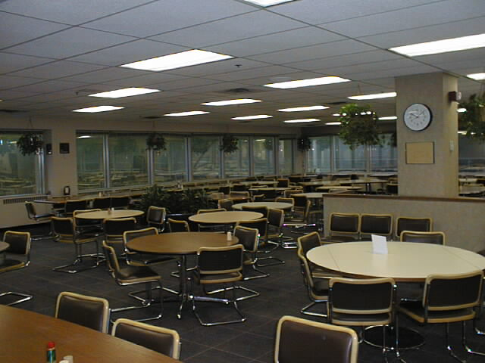
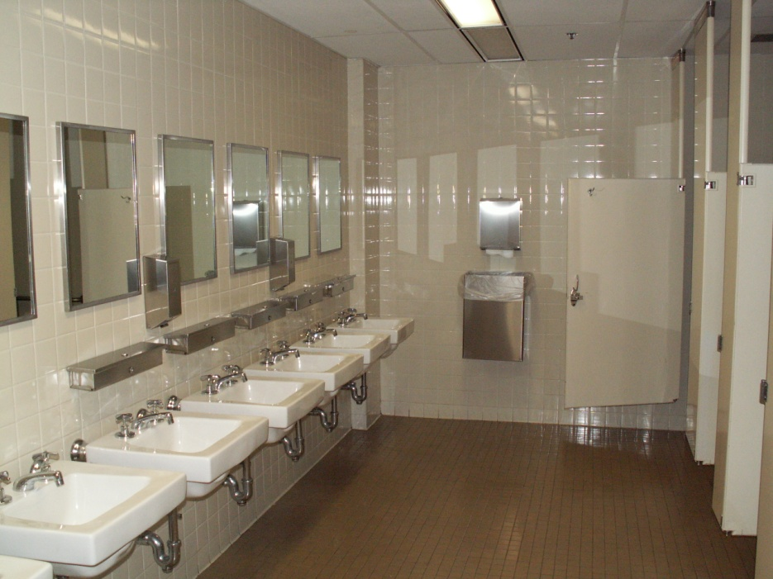
Amenity & Service Areas
Existing Cafeteria
Existing Bathroom

Slide 6
Getting the Best Return
Getting the Best Return
How do you position your building to get the most out of your amenity and service areas?

Slide 7
Existing
Occupant Area | 133,637 sq. ft.
Rentable Area | 175,382 sq. ft.
Load Factor B | 1.31238
Market Load Factor | 1.185

Slide 8
Existing
Potential loss due to excessive amenity and service areas
17,022 | Rentable Square Feet
$559,852 | Annual Net Operating Income
$7,000,000 | Building Value (using an 8% cap)

Slide 9
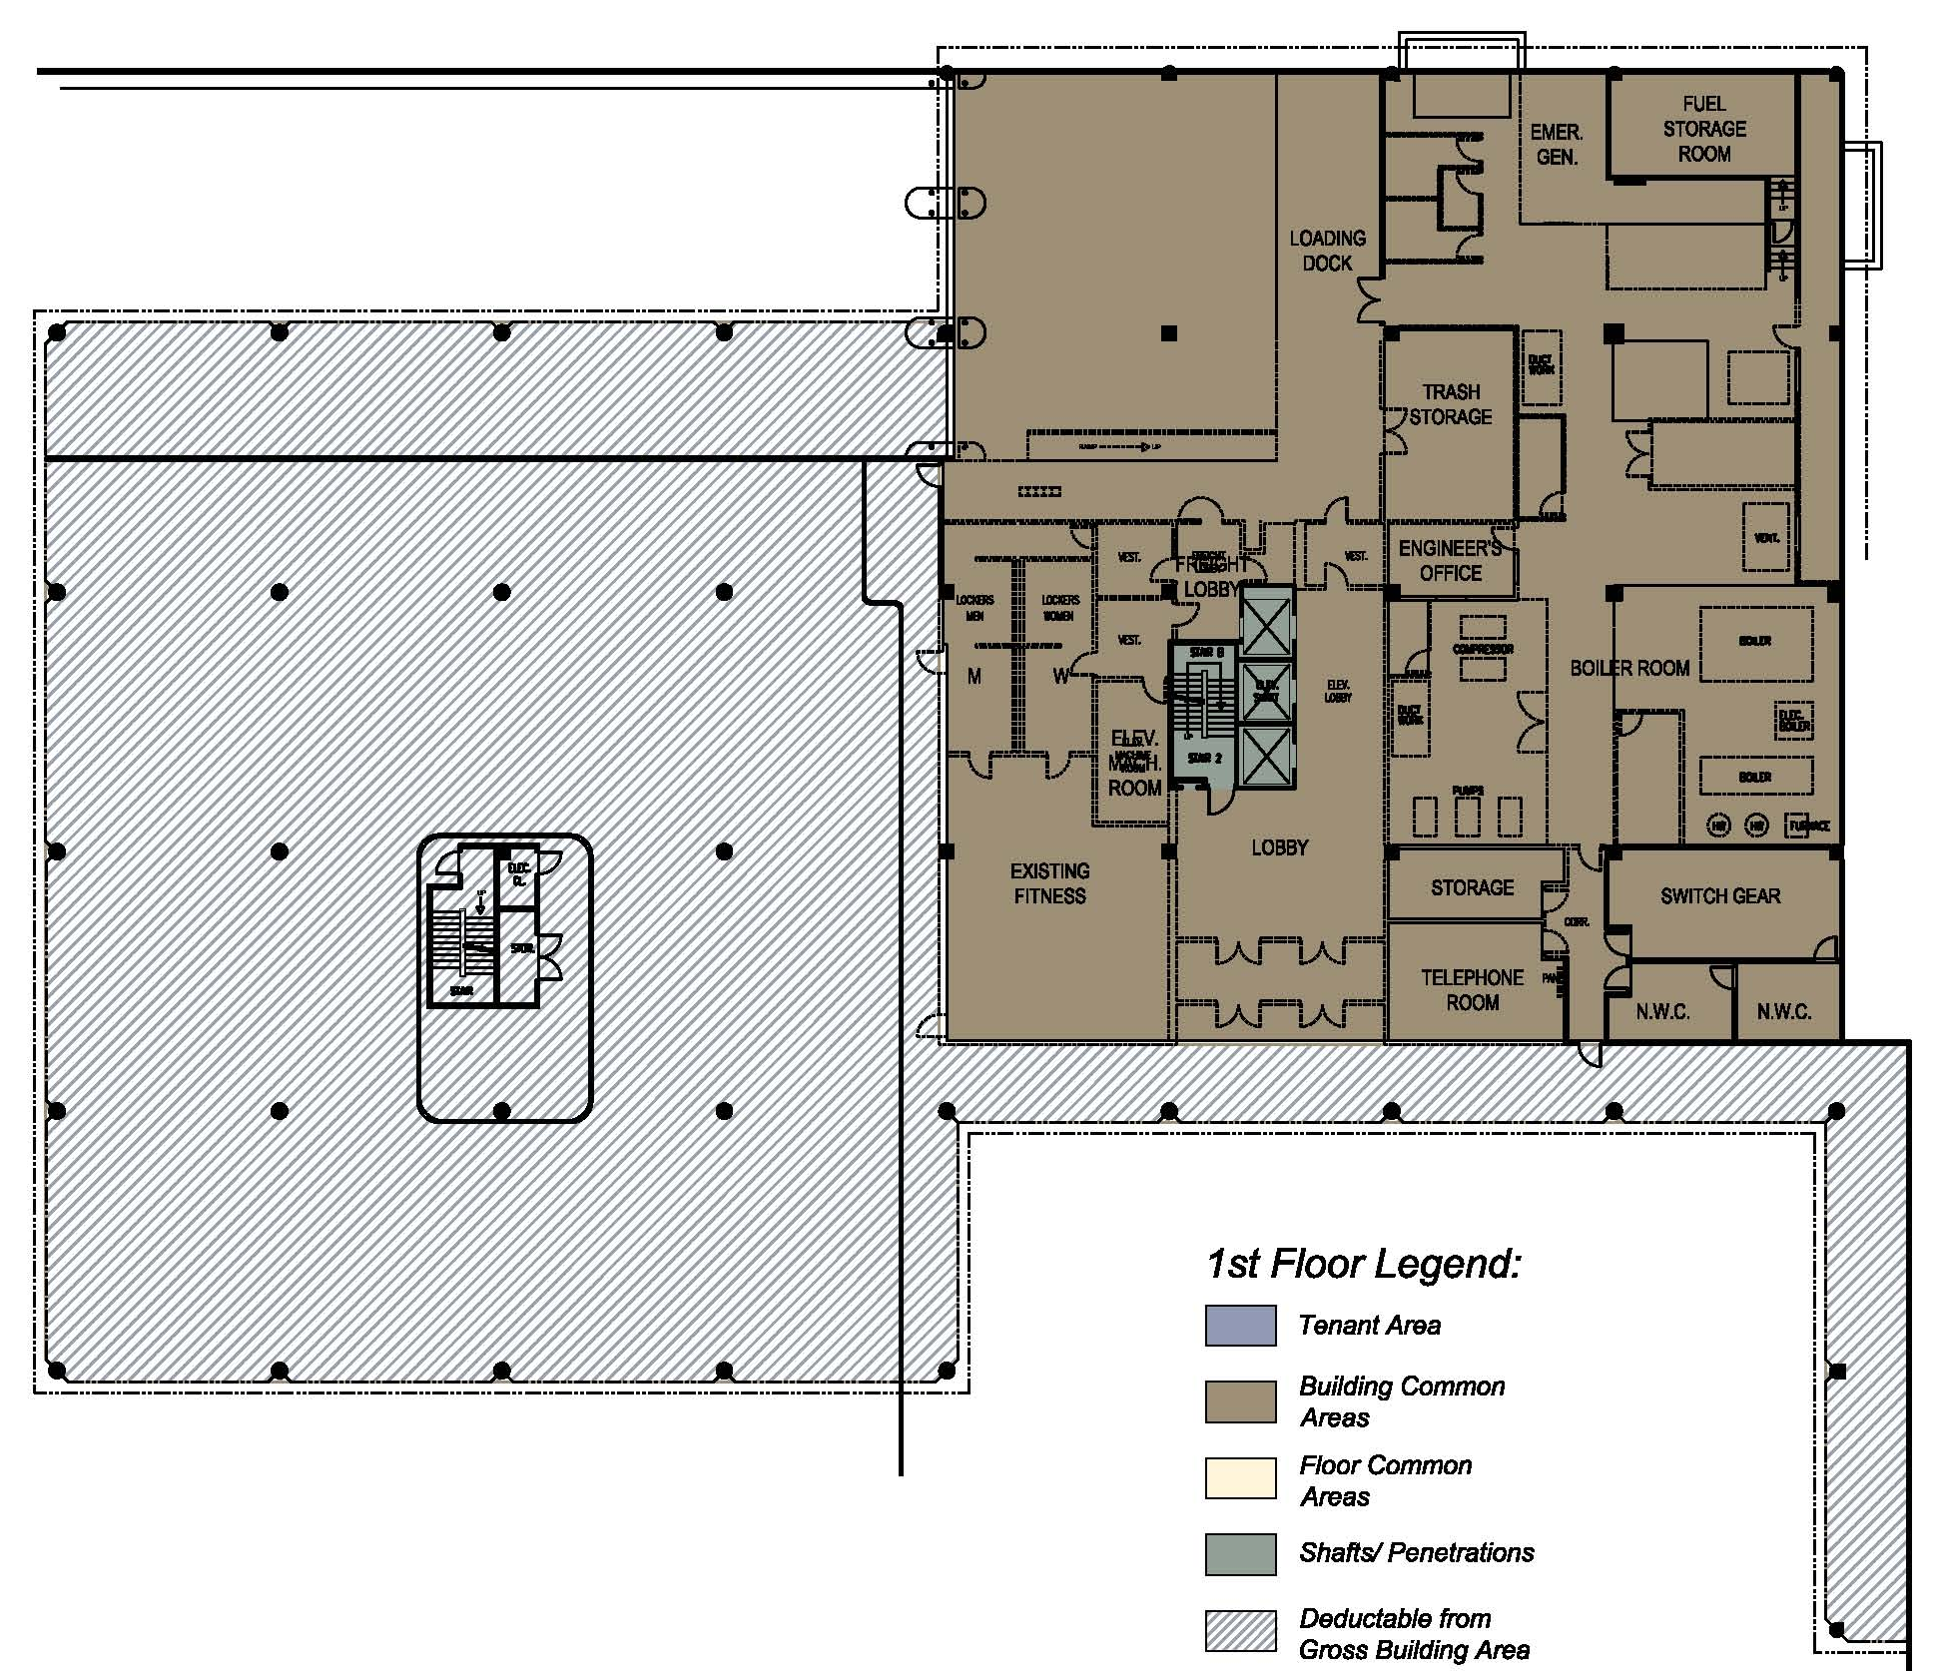

Existing 1st Floor

Slide 10
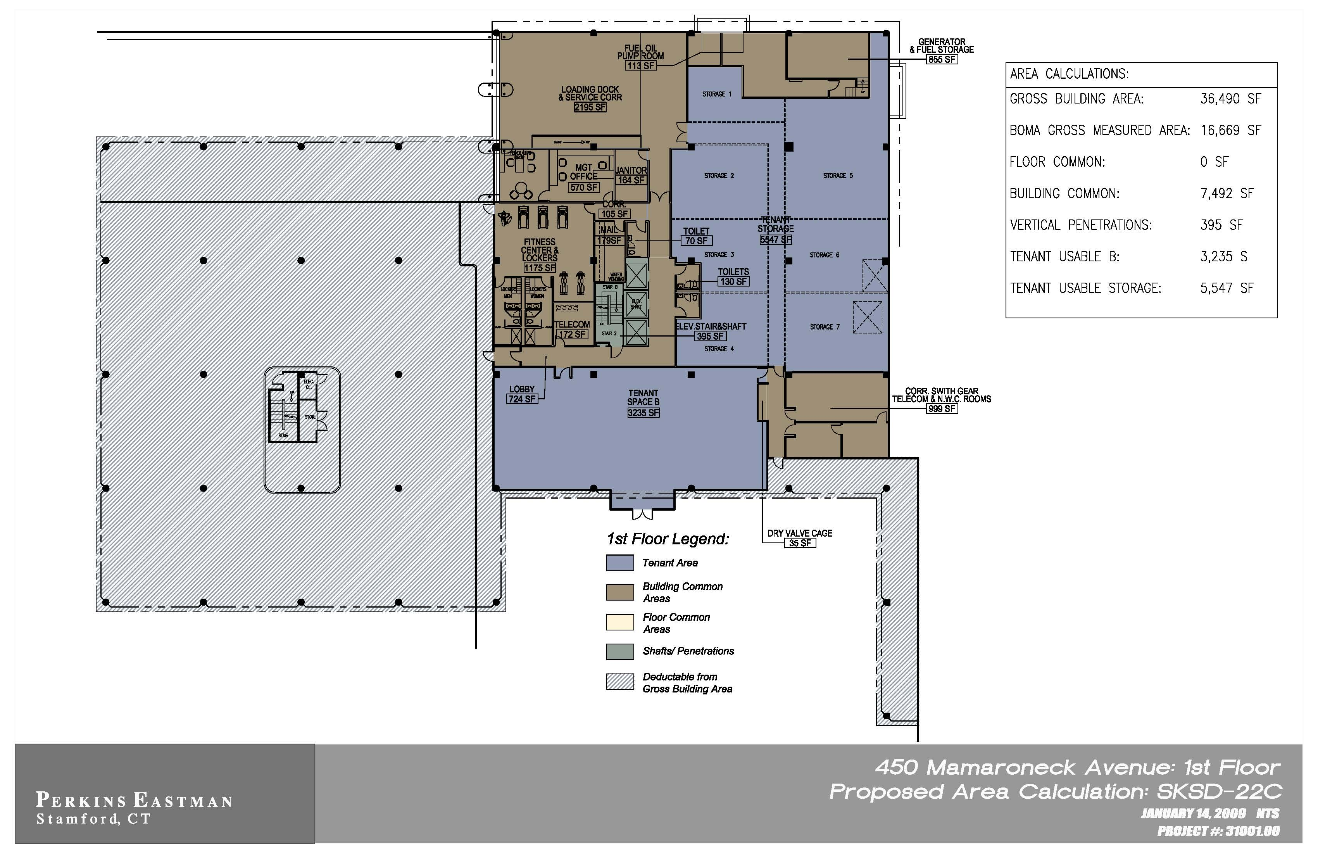
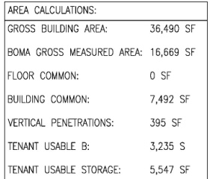
Repositioned 1st Floor

Slide 11
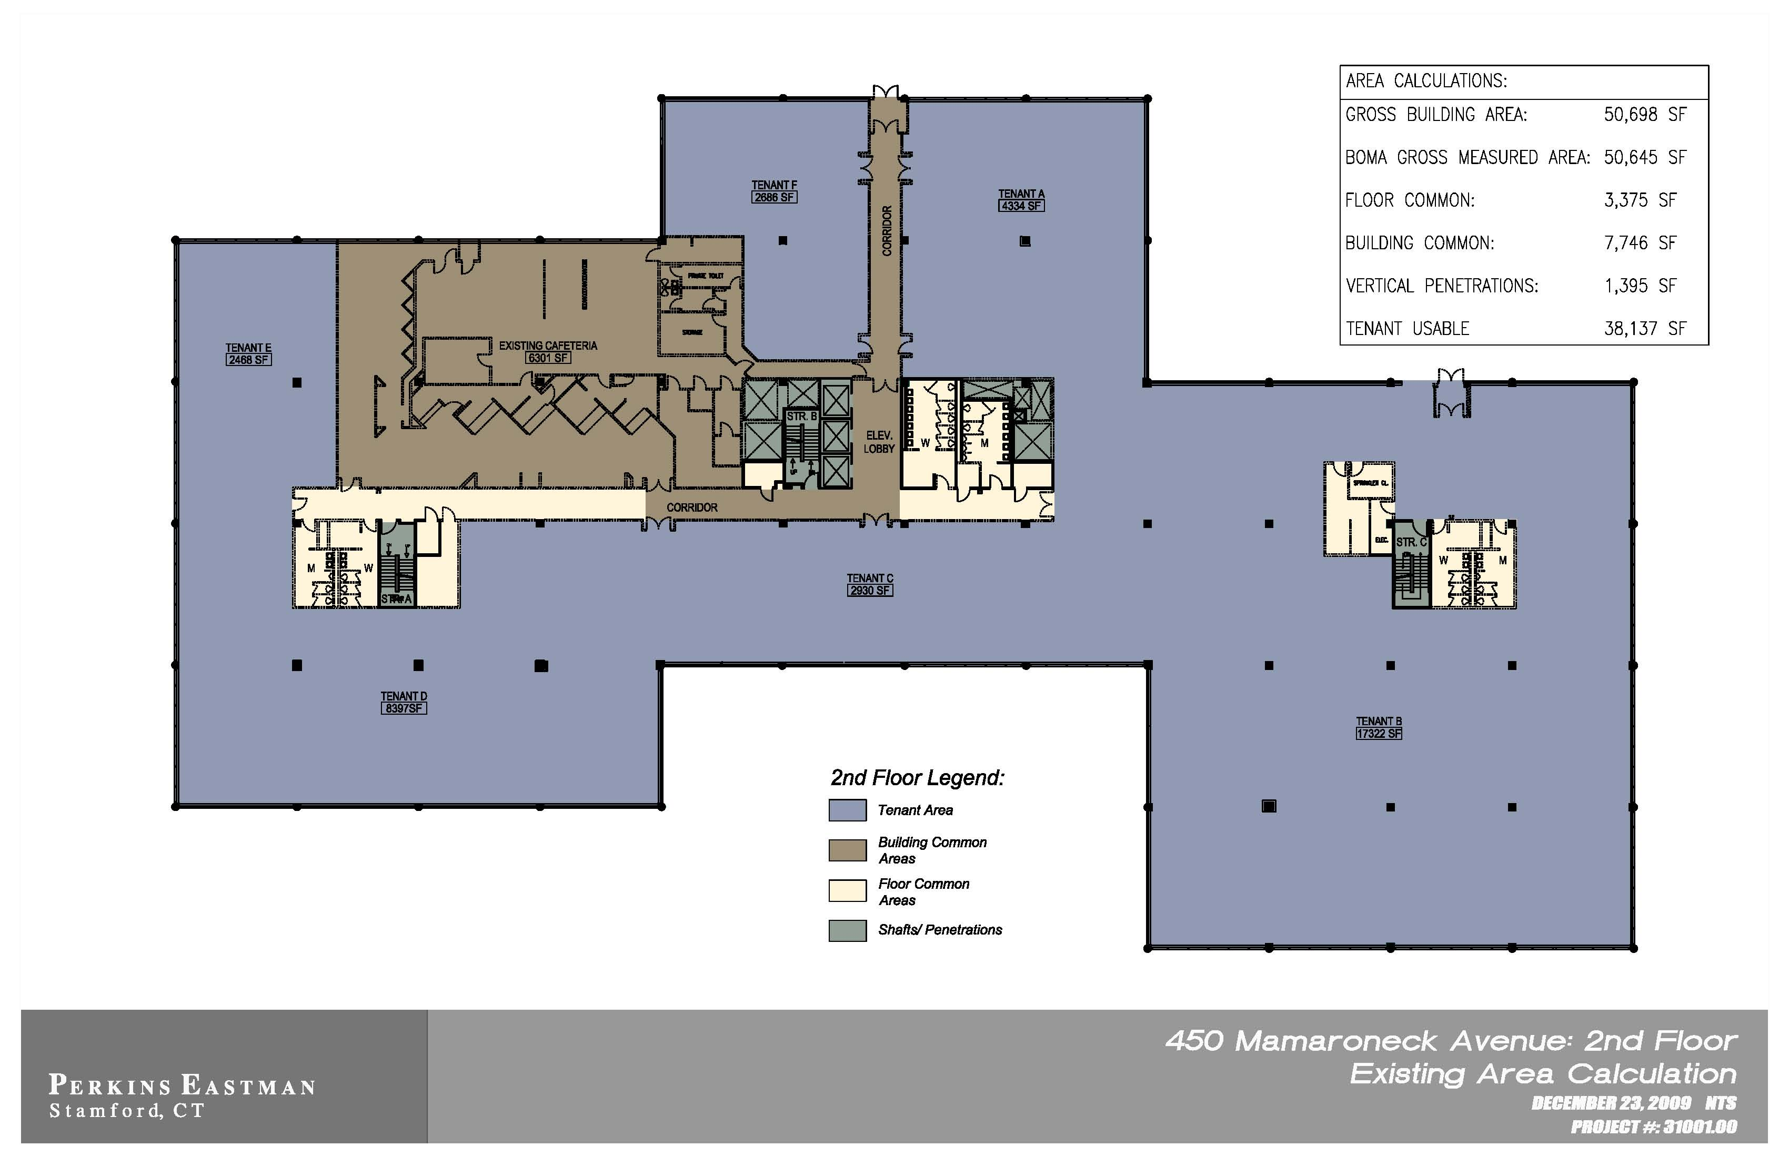
Existing 2nd Floor

Slide 12
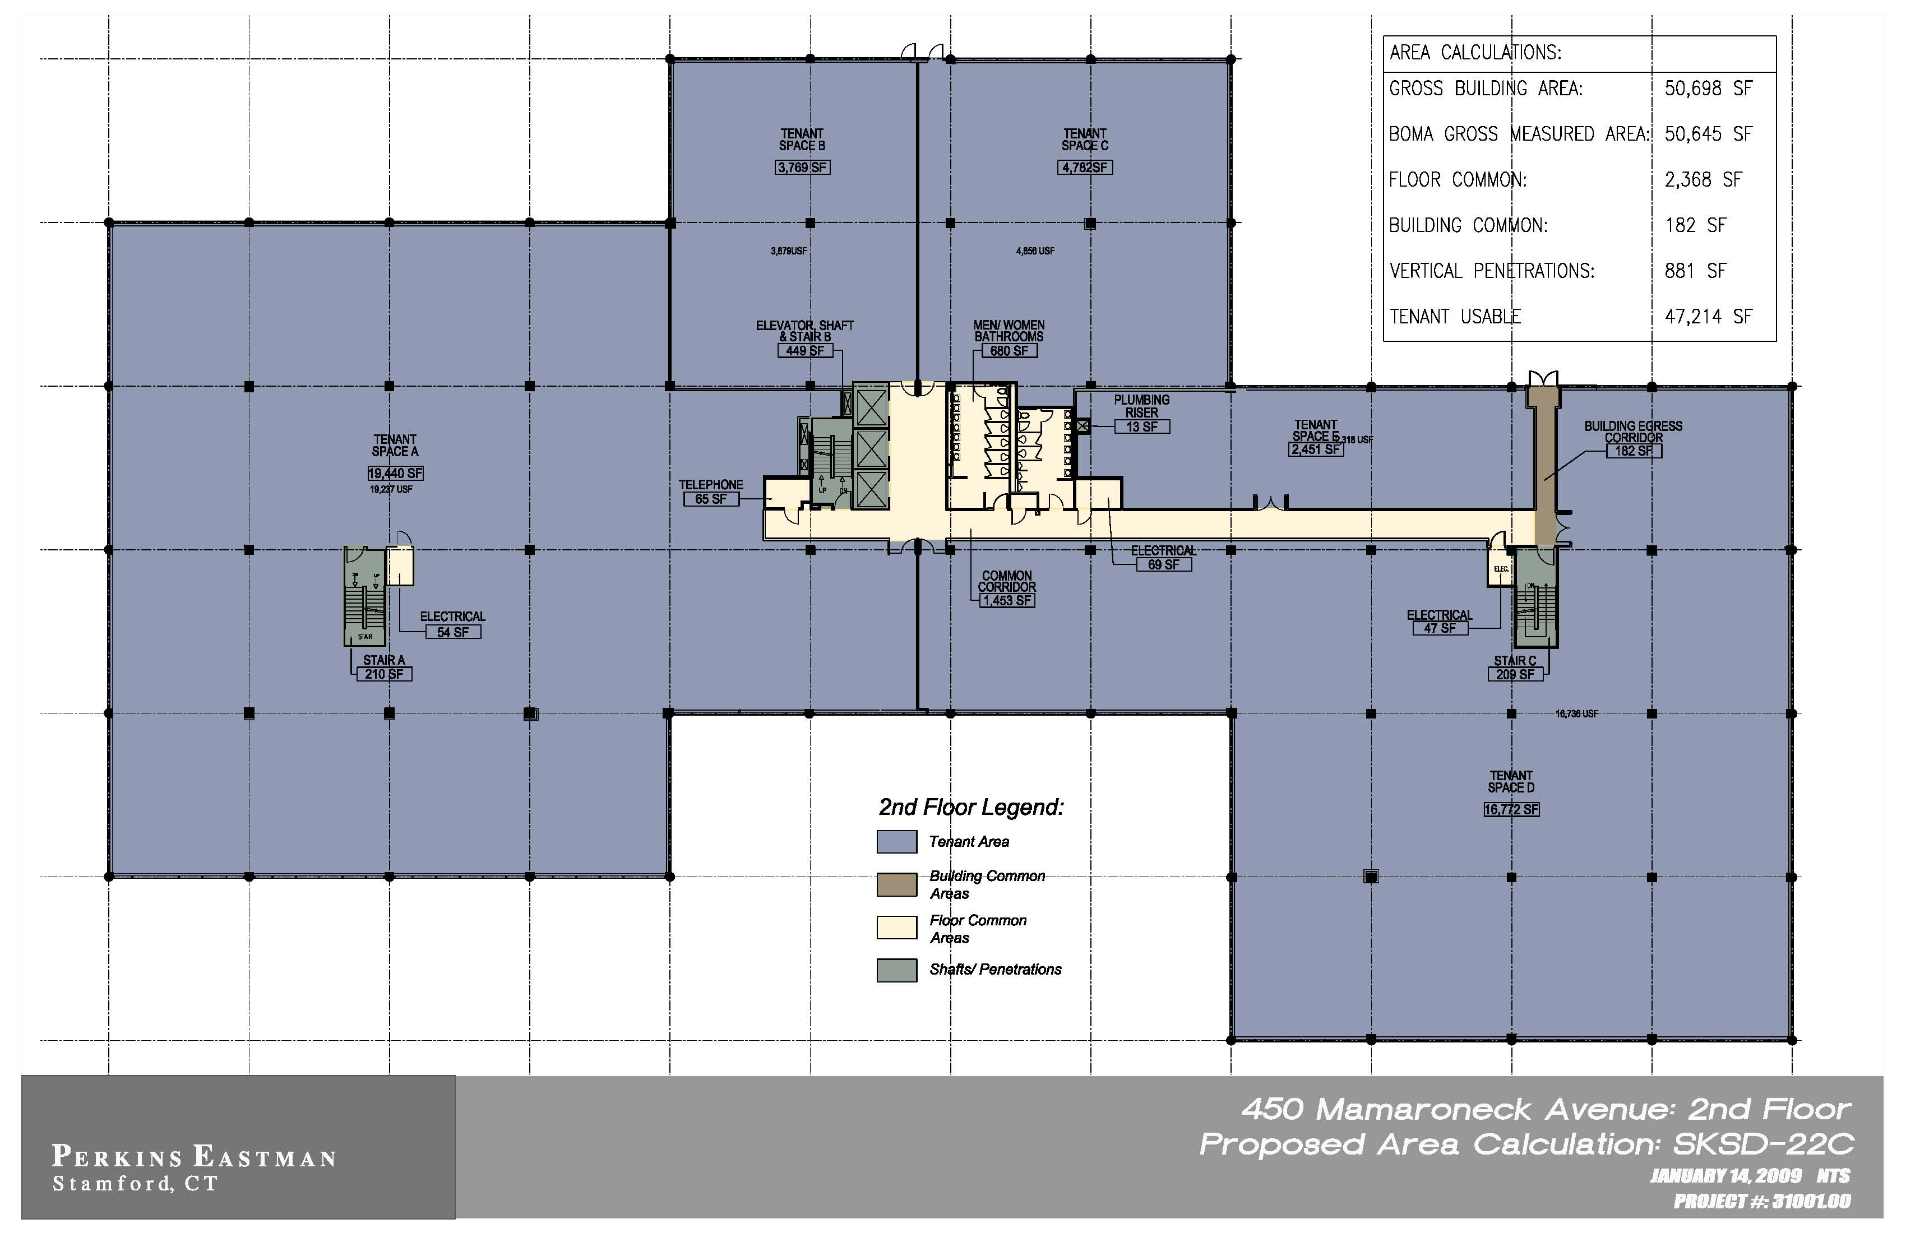
Repositioned 2nd Floor

Slide 13
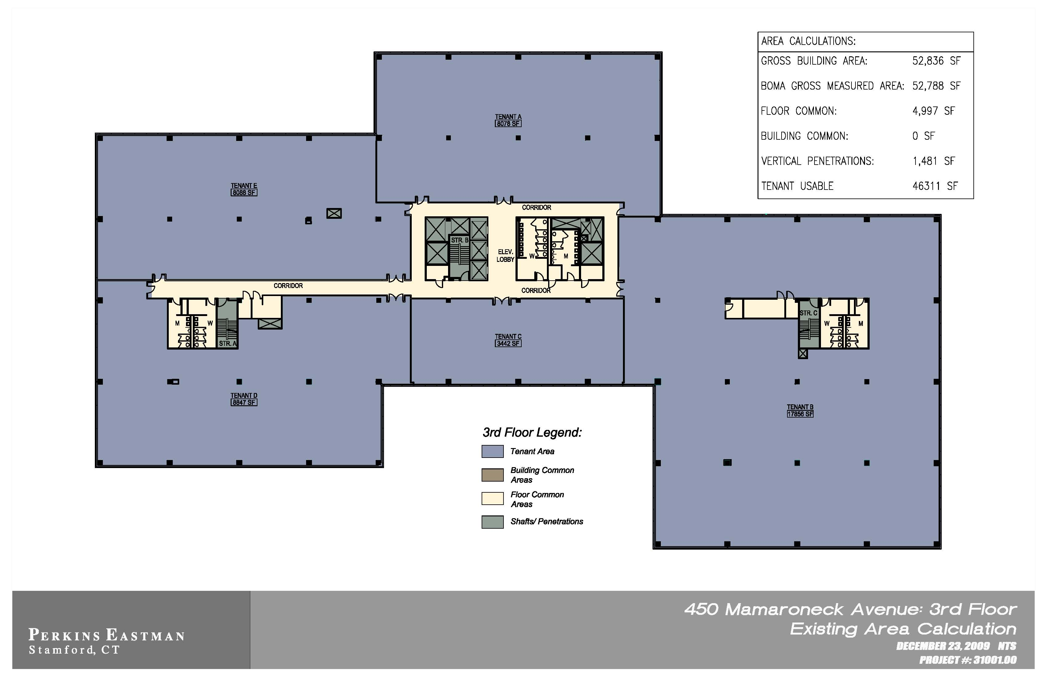
Existing 3rd Floor

Slide 14
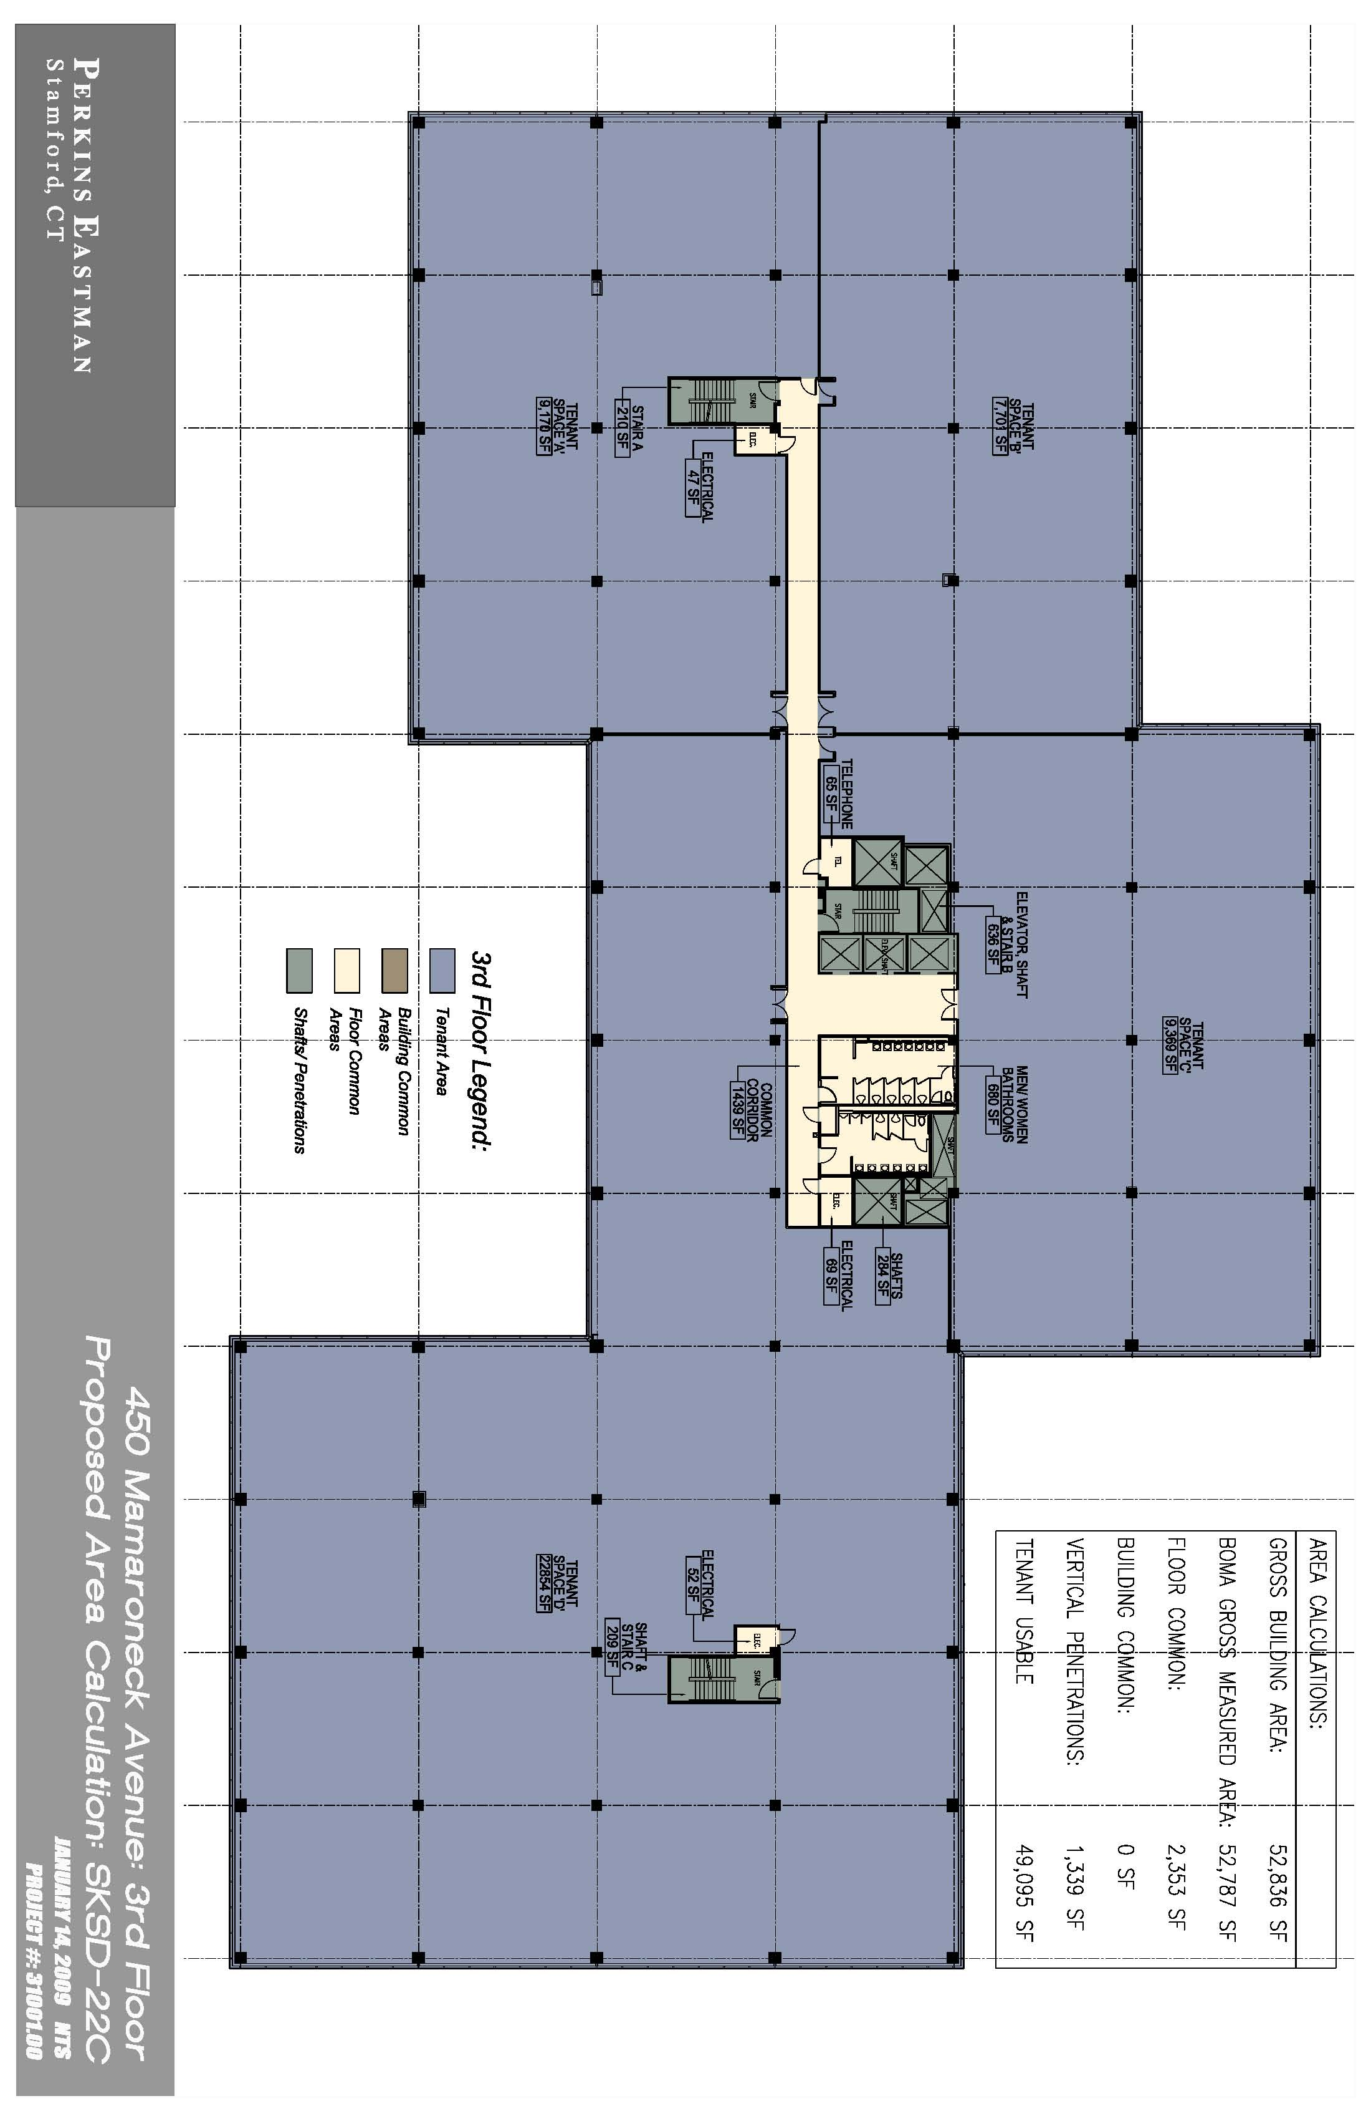
Repositioned 3rd Floor

Slide 15
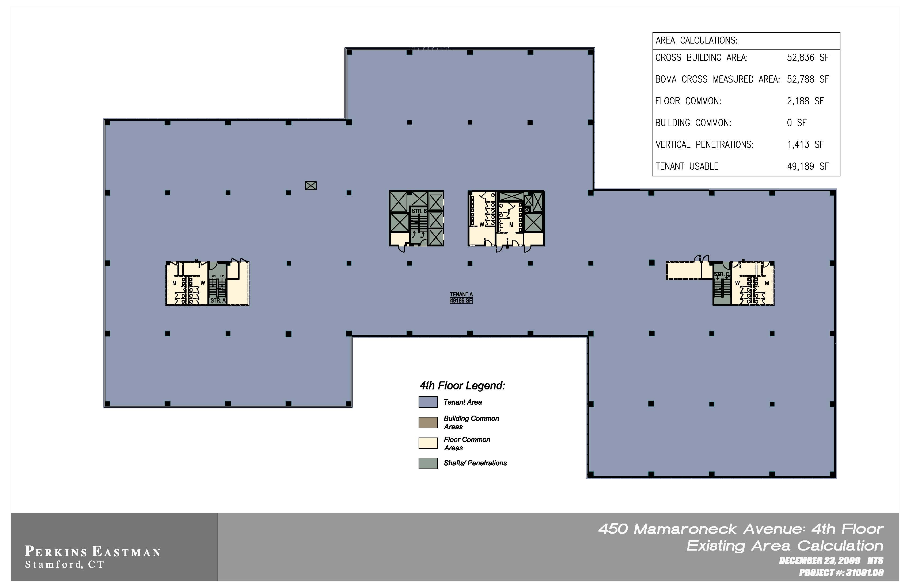
Existing 4th Floor

Slide 16
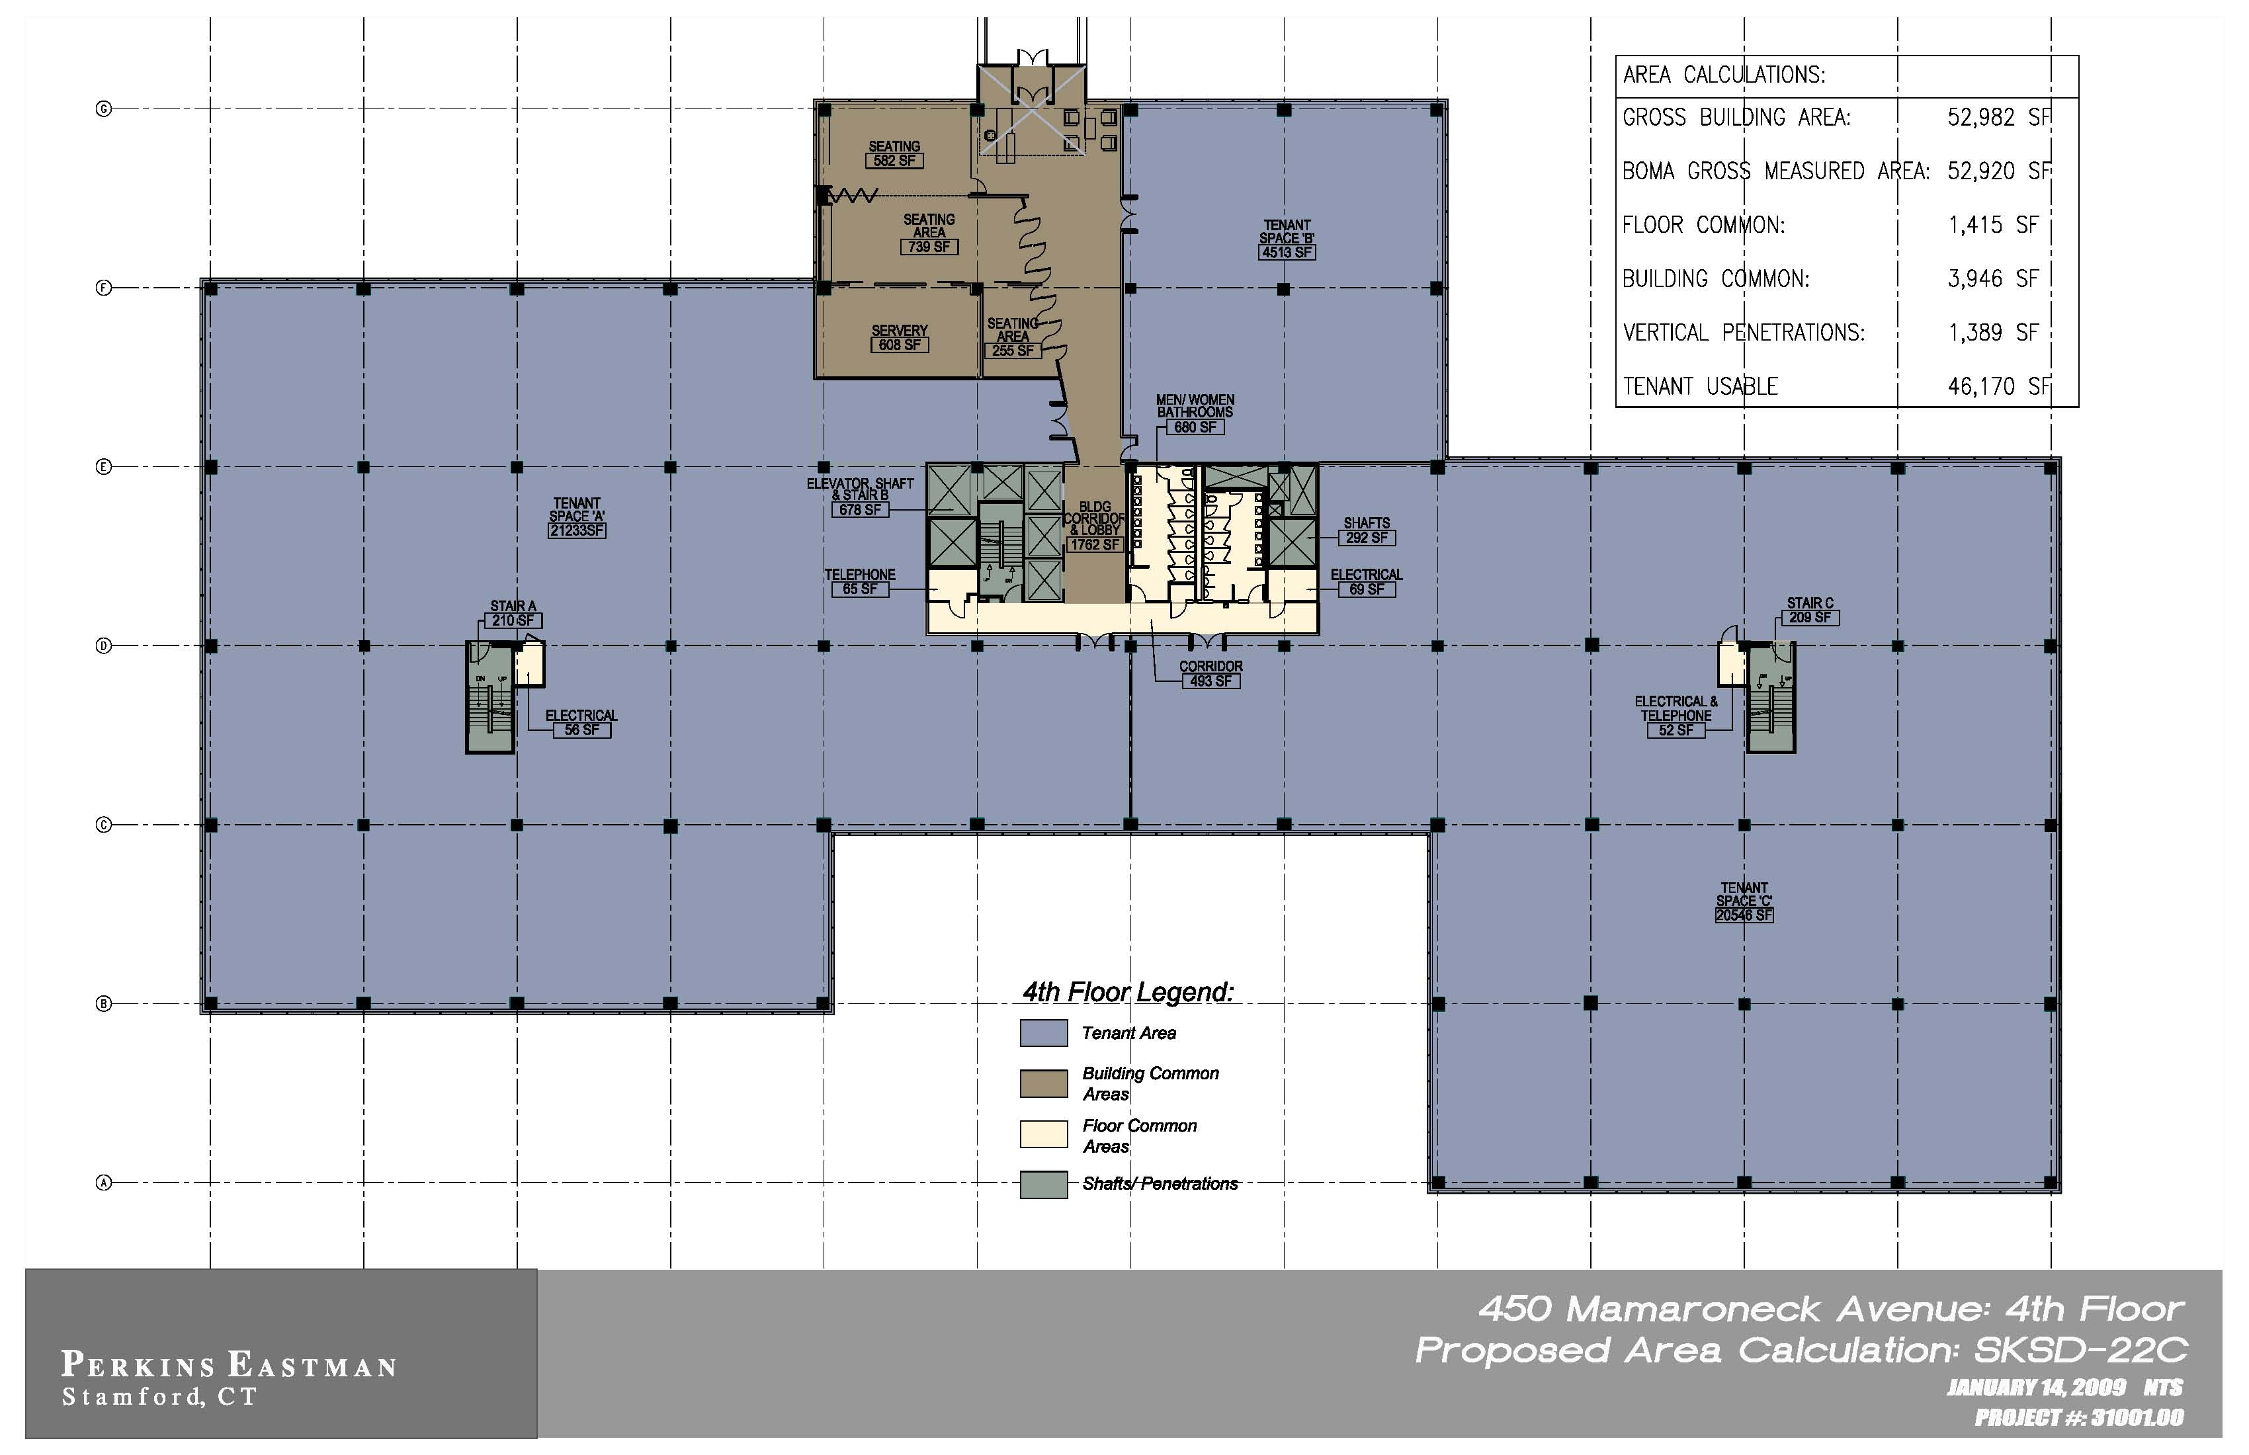
Repositioned 4th Floor

Slide 17
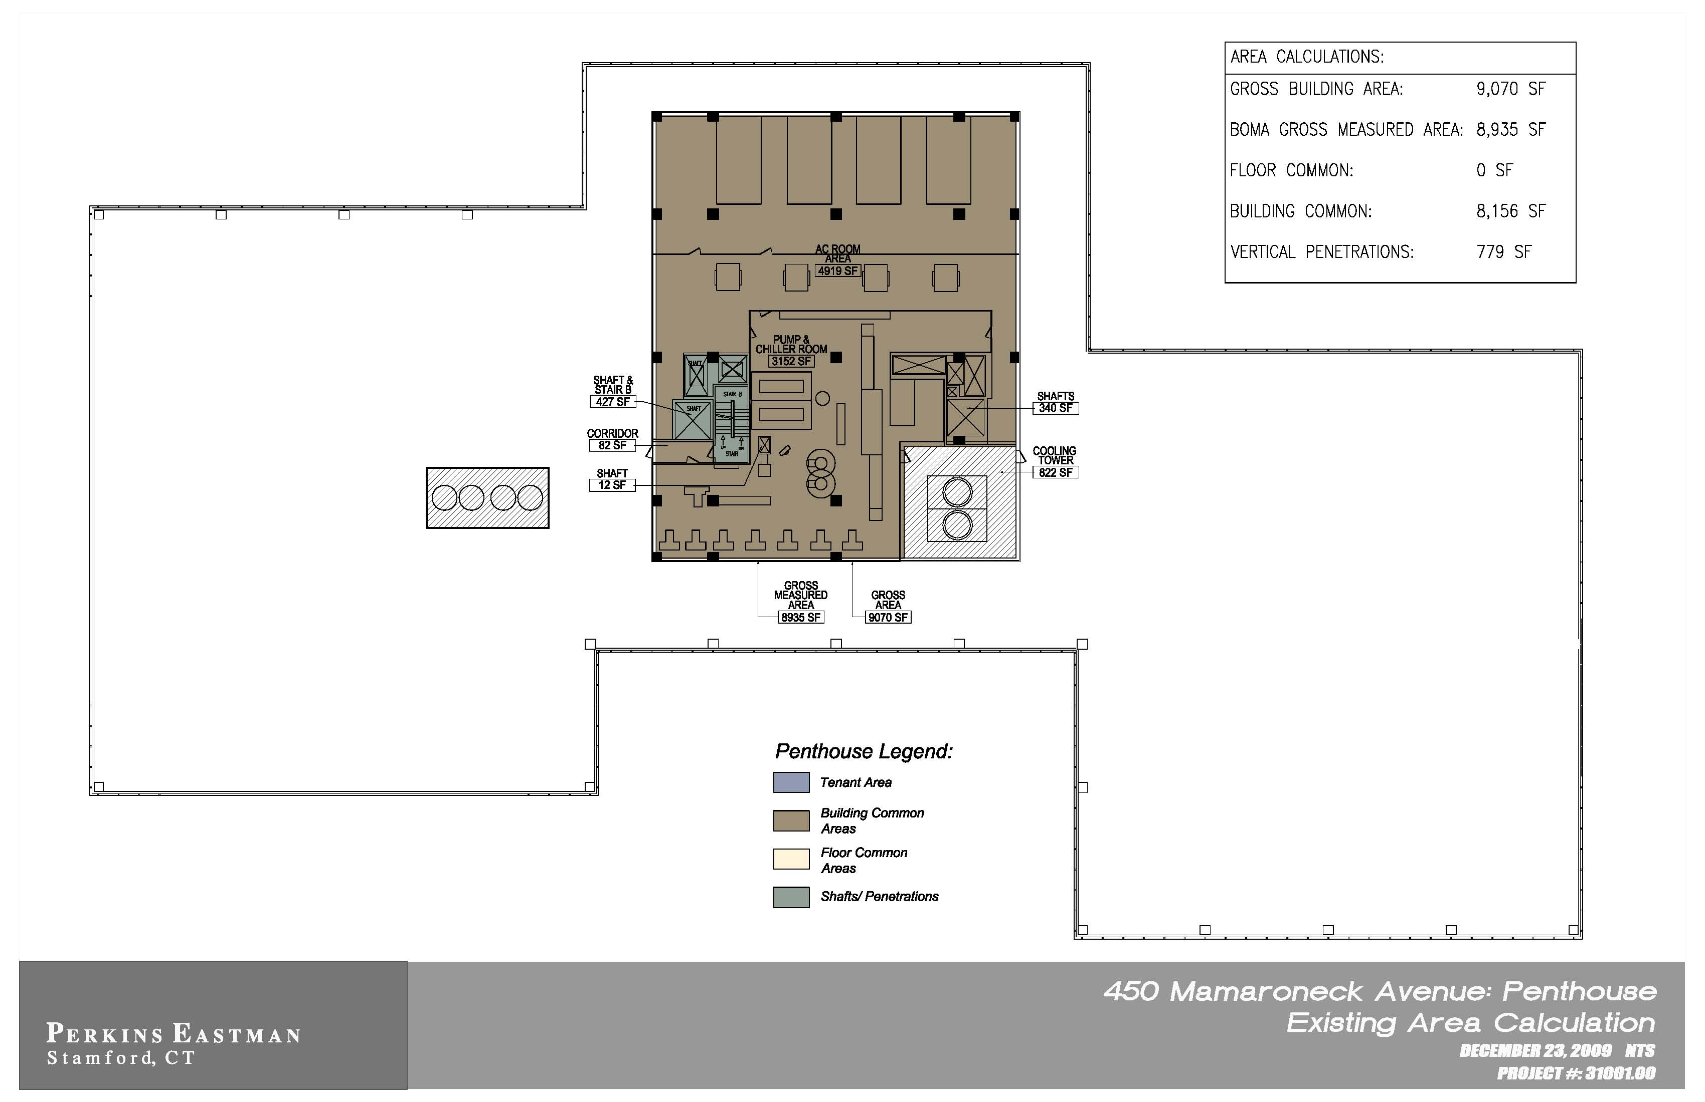
Existing 5th Floor
(Penthouse)

Slide 18
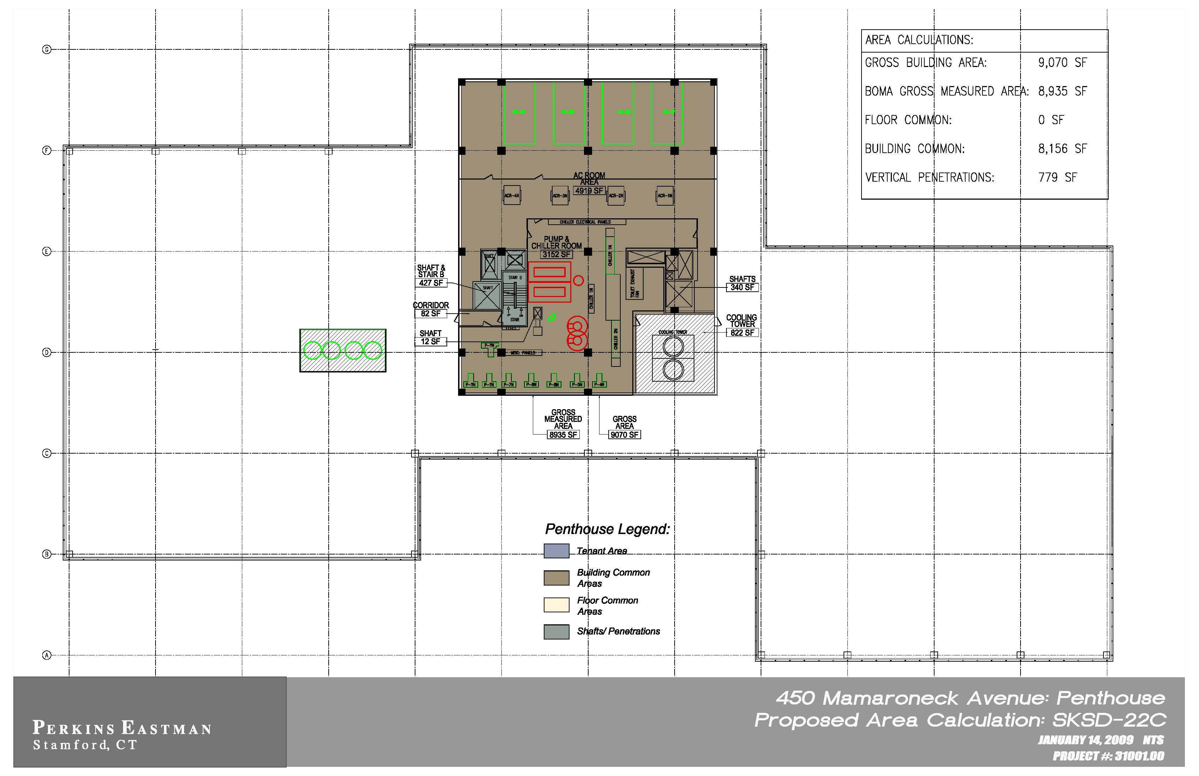
Repositioned 5th Floor
(Penthouse)

Slide 19
Existing
Repositioned
Occupant Area | 133,637 sq. ft. | 157,013 sq. ft.
Rentable Area | 175,382 sq. ft. | 177,173 sq. ft.
Load Factor B | 1.31238 | 1.17331

Slide 20
Repositioned
$610,680 | Annual Increase in NOI
$7.6 million | Increase to Building Value

Slide 21
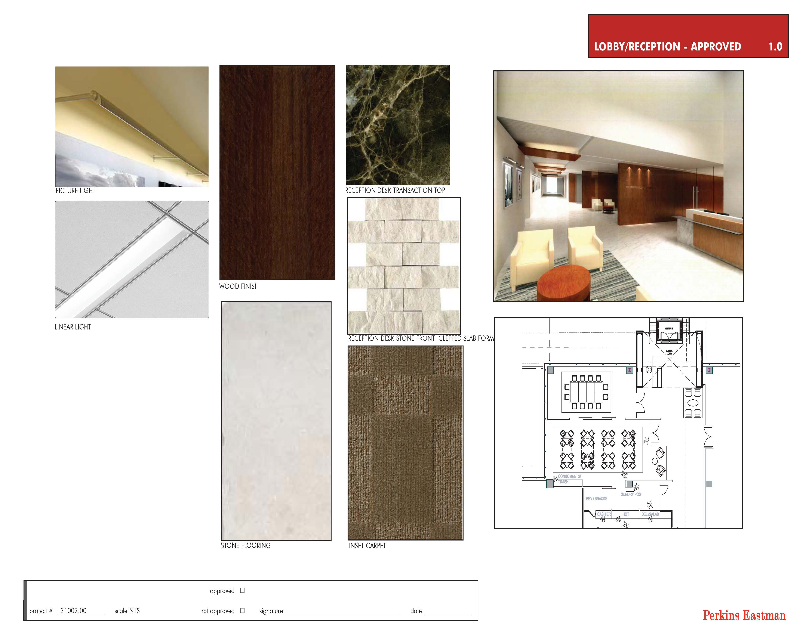
Additional Improvements by
Repositioning the Building
Renovated Lobby
Existing Lobby

Slide 22
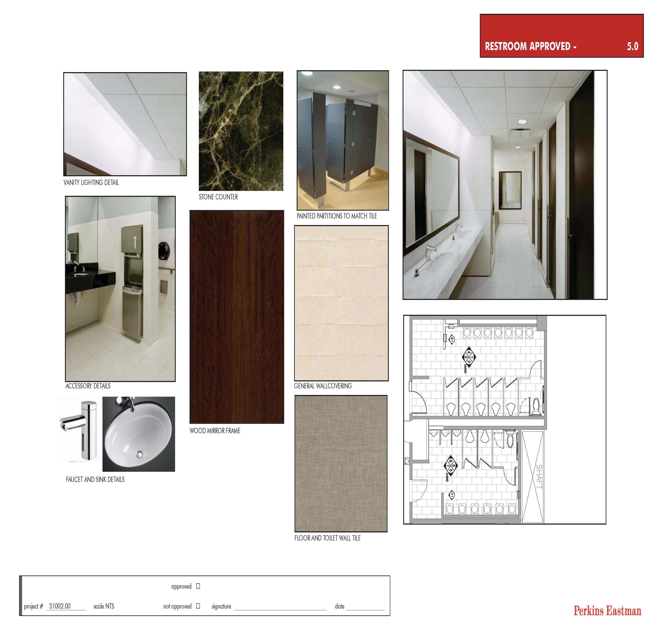
Restrooms
After
Before

Slide 23
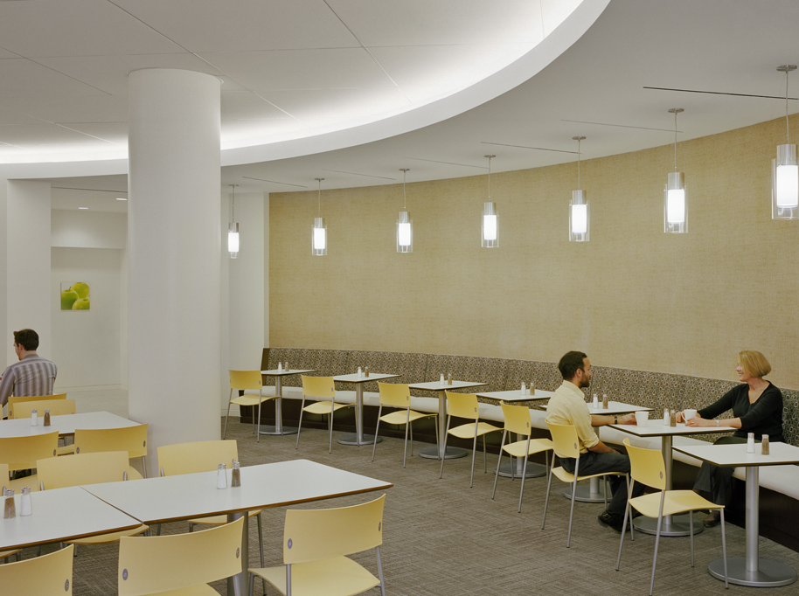
Cafeteria
After
Before

Slide 24
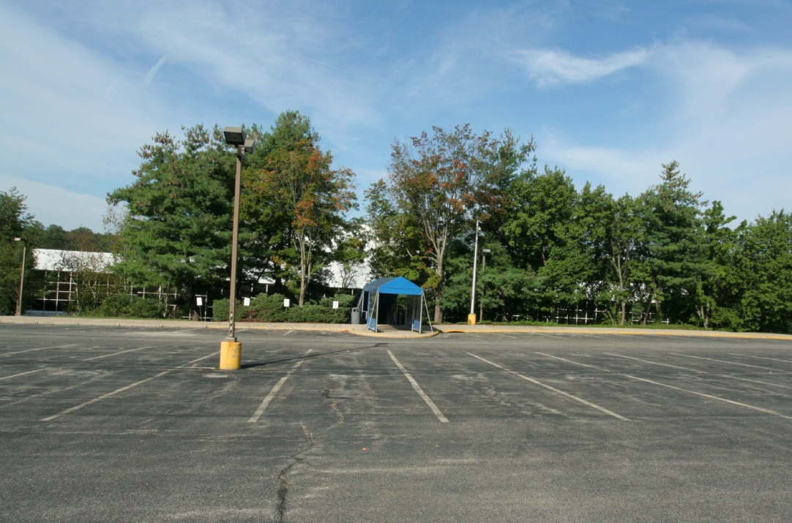
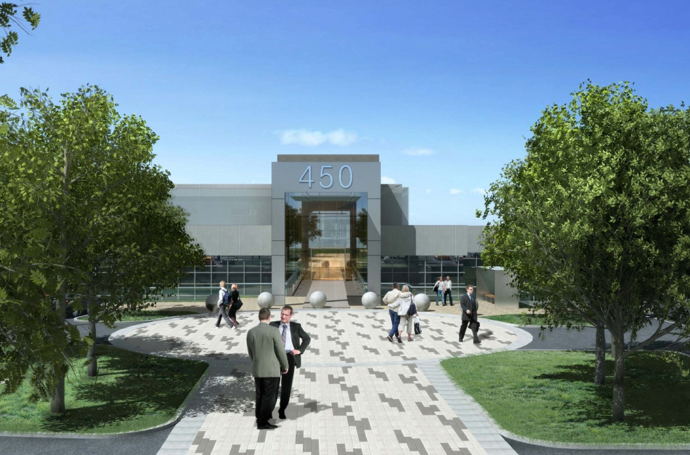
Rear Entrance
After
Before

Slide 25
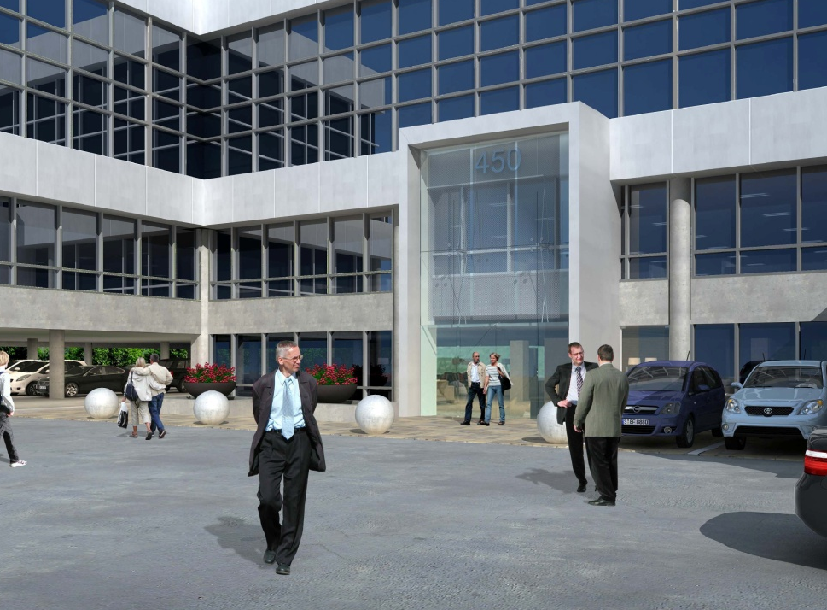
Front Entrance
After
Before

Slide 26

Designation Examination:
BOMA 360
The BOMA 360 designation provides validation and industry recognition of buildings that demonstrate best practices encompassing all major aspects of building management and operations.
Notes:
In an increasingly competitive marketplace, there is a need not only to improve how buildings operate, but to focus on how commercial properties are managed. One designation providing recognition for operational and management excellence that has gained traction across the globe is the BOMA 360 Performance Program. Unlike other designation or certification programs like LEED, which focus only on certain areas of operations, such as energy performance and sustainability, the 360 Performance Program is a holistic evaluation of all major areas of building management and operations. To date, more than 1,100 designations have been earned by buildings in 63 markets worldwide.

Slide 27

BOMA 360: Criteria
Administered by an independent council
Evaluates building performance against industry best practices
Examines 6 key areas of building operations and management:
  Building operations and management;
  Life safety/security/risk management;
  Training and education;
  Energy;
  Environment/sustainability; and
  Tenant relations/community involvement
Satisfy requirements in all 6 areas to be awarded the prestigious designation

Slide 28
BOMA 360: Value
Maximizes operational performance
Identifies areas of strength/need for improvement
Ensures continuing standards of property maintenance
Increases sustainability/environmental practices
Improves overall management quality
Management transparency = Recognition
Serves as a training tool for property personnel
Differentiates building in the marketplace, providing tangible benefits to the property

Slide 29
BOMA 360: Value
Tenants Rate 360 Buildings Better
BOMA 360 buildings rate higher in all 54 rating areas of tenant satisfaction measured by the Kingsley Index.
95% of tenants in BOMA 360 buildings report high overall satisfaction with property management.
91% of tenants would recommend their office building to others versus 87% in non-360 buildings.
78% are satisfied with the value received from the amount of rent paid versus 72% in non-360 buildings.

Slide 30
BOMA 360: Value
Tangible Benefits
BOMA 360 buildings command higher rents than other Class A buildings.
BOMA 360 buildings have higher tenant retention rates than other Class A buildings.
BOMA 360 buildings have lower vacancy rates than other Class A buildings.

Slide 31
BOMA 360: Value
Increased NOI

Slide 32
BOMA 360: Value
BOMA 360 Buildings Outperform LEED

Slide 33
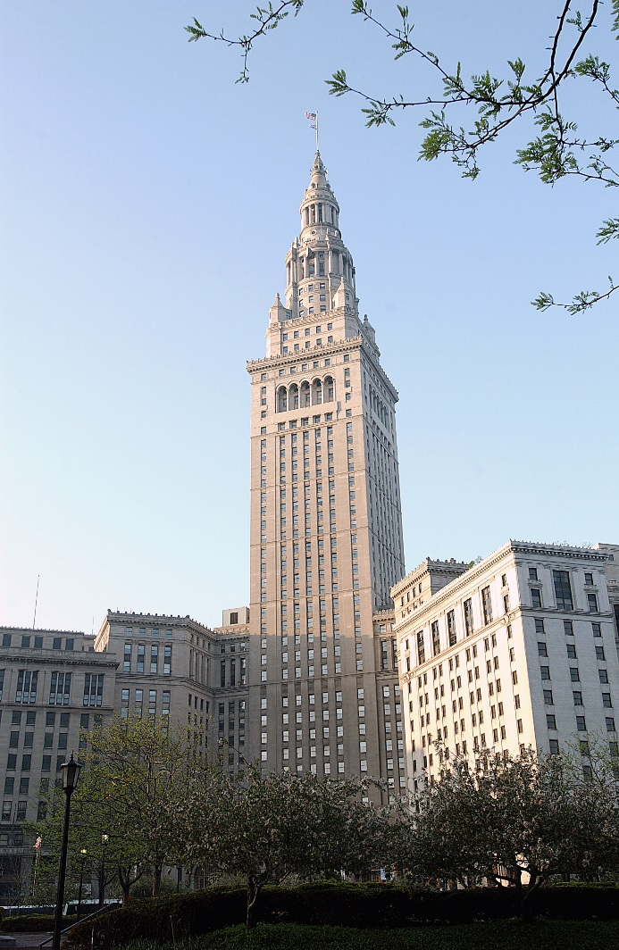
BOMA 360: Case Studies
Terminal Tower
Cleveland, Ohio, United States
Innovation in the Central Business District
Notes:
Cleveland’s historic Terminal Tower stands as the crown jewel of city’s skyline and is a shining example of a nearly century old asset operating at 21st century standards. Earning the BOMA 360 designation differentiated the Tower from other office properties in downtown Cleveland. The designation served to instill pride in owner and management firm Forrest City Enterprises’ property management team, and confirmed to current and prospective tenants the overall superiority of this historic property.

Slide 34
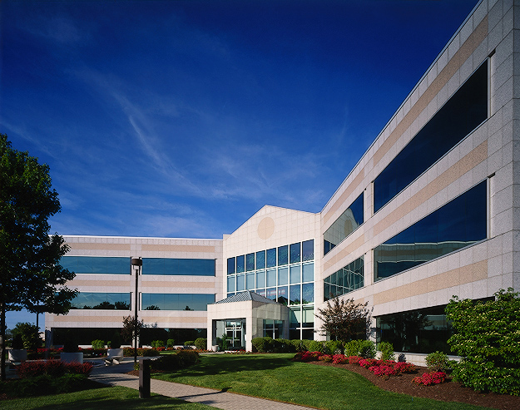
BOMA 360: Case Studies
Brandywine Realty Trust
Philadelphia Metro, USA
Keeping Suburban Markets Competitive
Notes:
By achieving the BOMA 360 designation for its 8 owned and managed buildings in southern New Jersey and suburban Philadelphia, Brandywine used the 360 program to establish a clear management vision for its properties and bring the management teams together around a single set of recognized industry best practices. The result—their suburban portfolio successfully competes with top-performing buildings in major urban areas.

Slide 35
BOMA 360: Case Studies
Newell Rubbermaid
Global Headquarters
Atlanta, Georgia, USA
Achieving Corporate Facility Excellence
Notes:
For Rubbermaid Commercial Products, achieving the BOMA 360 designation for its global headquarters building in Atlanta was the pinnacle of a long list of recognitions and awards. The program served as a valuable assessment tool, requiring Rubbermaid’s property management team to assemble and catalog its operational strategies and measure them against BOMA’s 360 best practices criteria and feels that the BOMA 360 program “is a roadmap to follow on your journey to being best in class.”

Slide 36
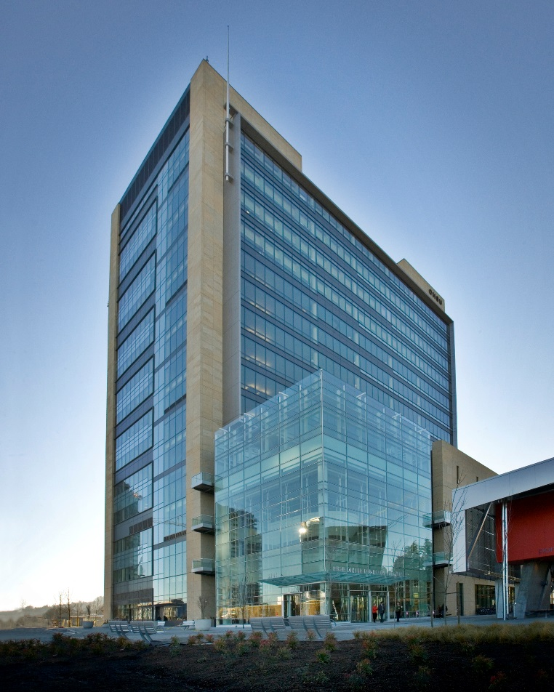
BOMA 360: Case Studies
OHSU Center for Health
And Healing
Portland, Oregon, USA
Wellness Check-Up for MOBs
Notes:
The OHSU Center for Health and Healing is a large, complex medical office building in Portland. They found the BOMA 360 program especially useful when assessing the multidimensional nature of MOB operations. By achieving the 360 designation and promoting their 360 designation in their marketing materials, it helped brand their building as one of the most environmentally aware facilities in the country and instilled a sense of pride and motivation in those who work at OHSU.

Slide 37
THANK YOU!
спасибо
Kent Gibson, BOMA Fellow
Chair and CEO of BOMA International
President of
Capstone Property Management, L.C.

