Slide 1
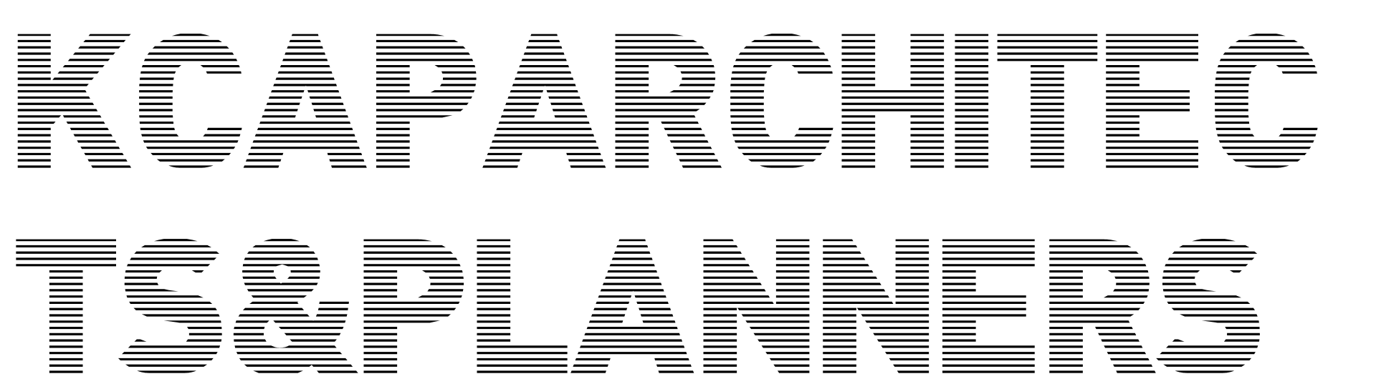

Back to Architecture and Planning
Centralities / Mass and Fabric
Ruurd Gietema
Urban Planner / Partner KCAP

Slide 3
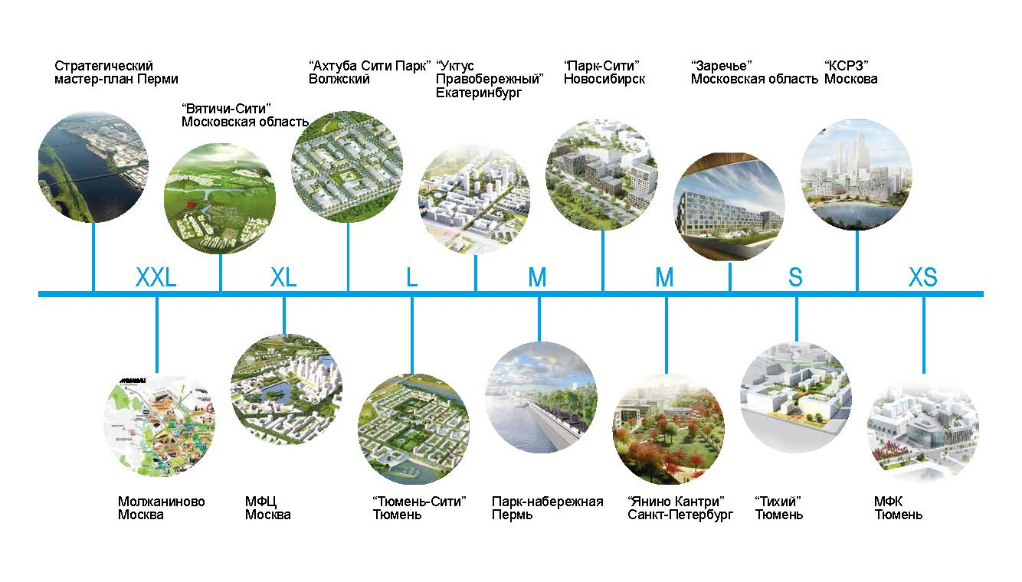

Slide 4
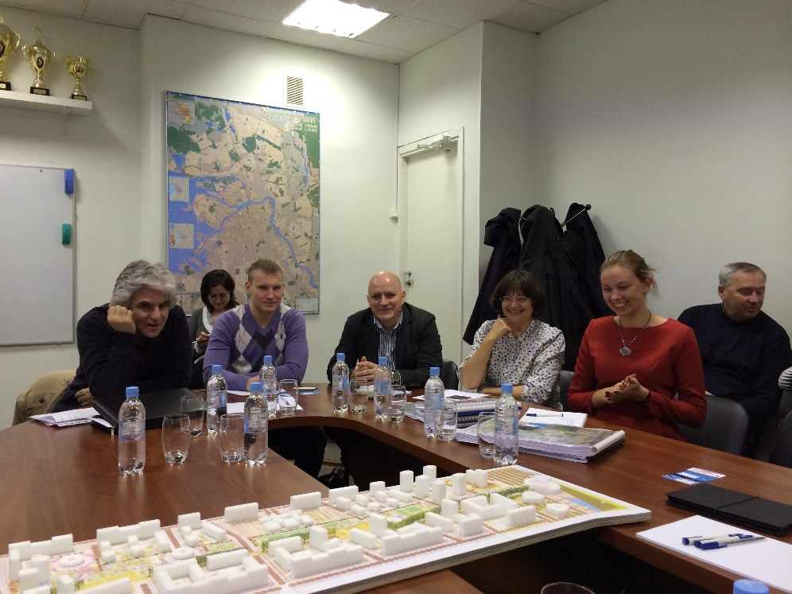
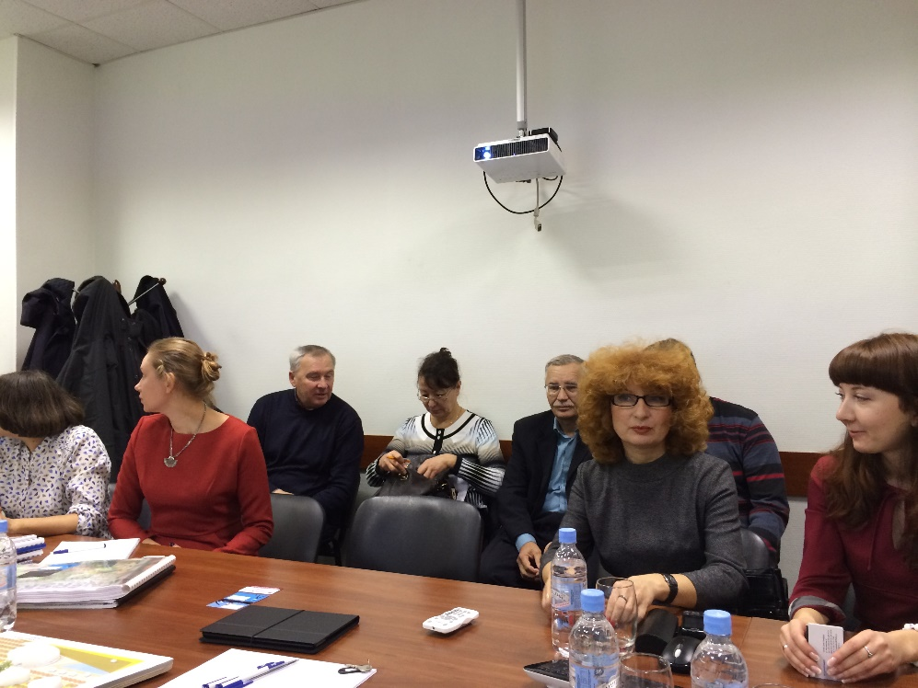
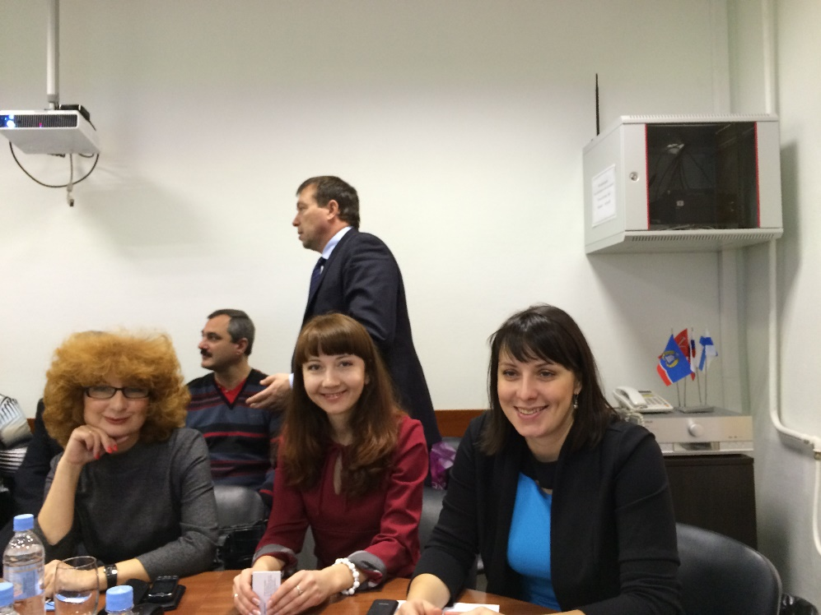

Slide 5
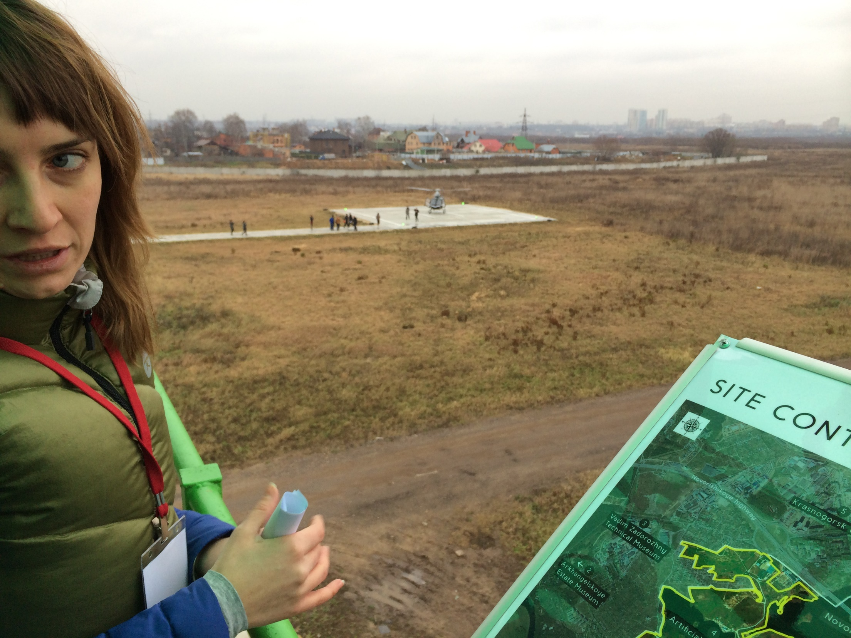

Slide 6
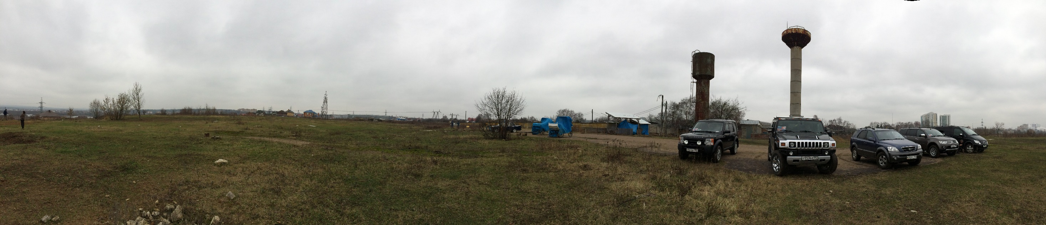
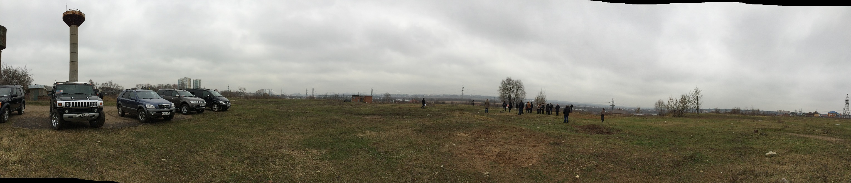

Slide 7
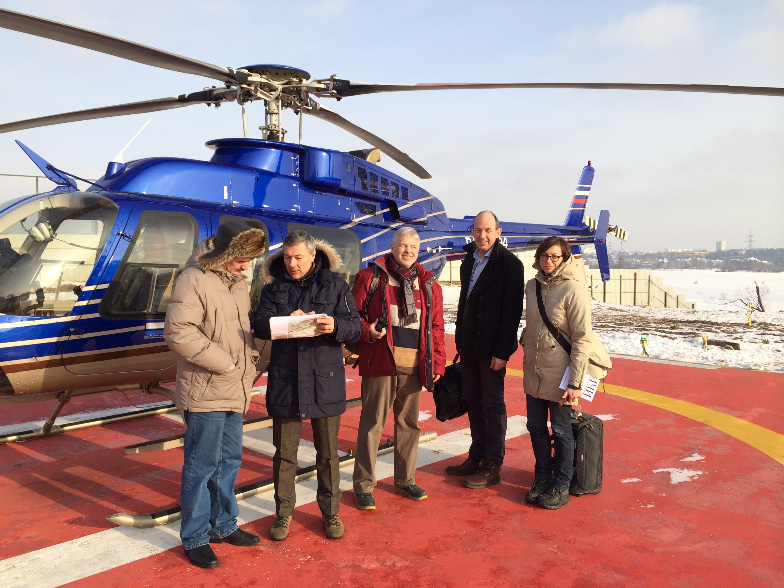

Slide 8
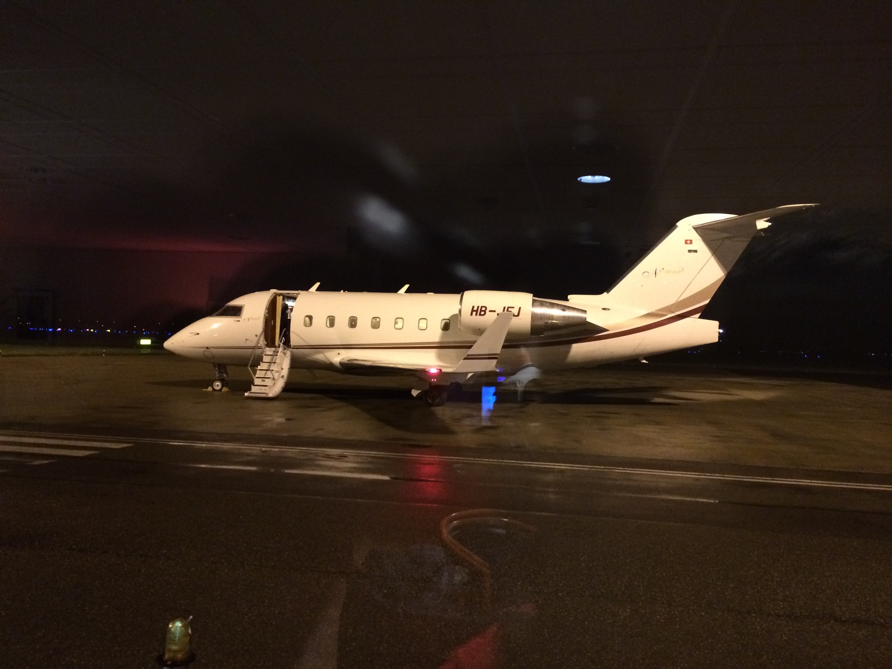

Slide 9
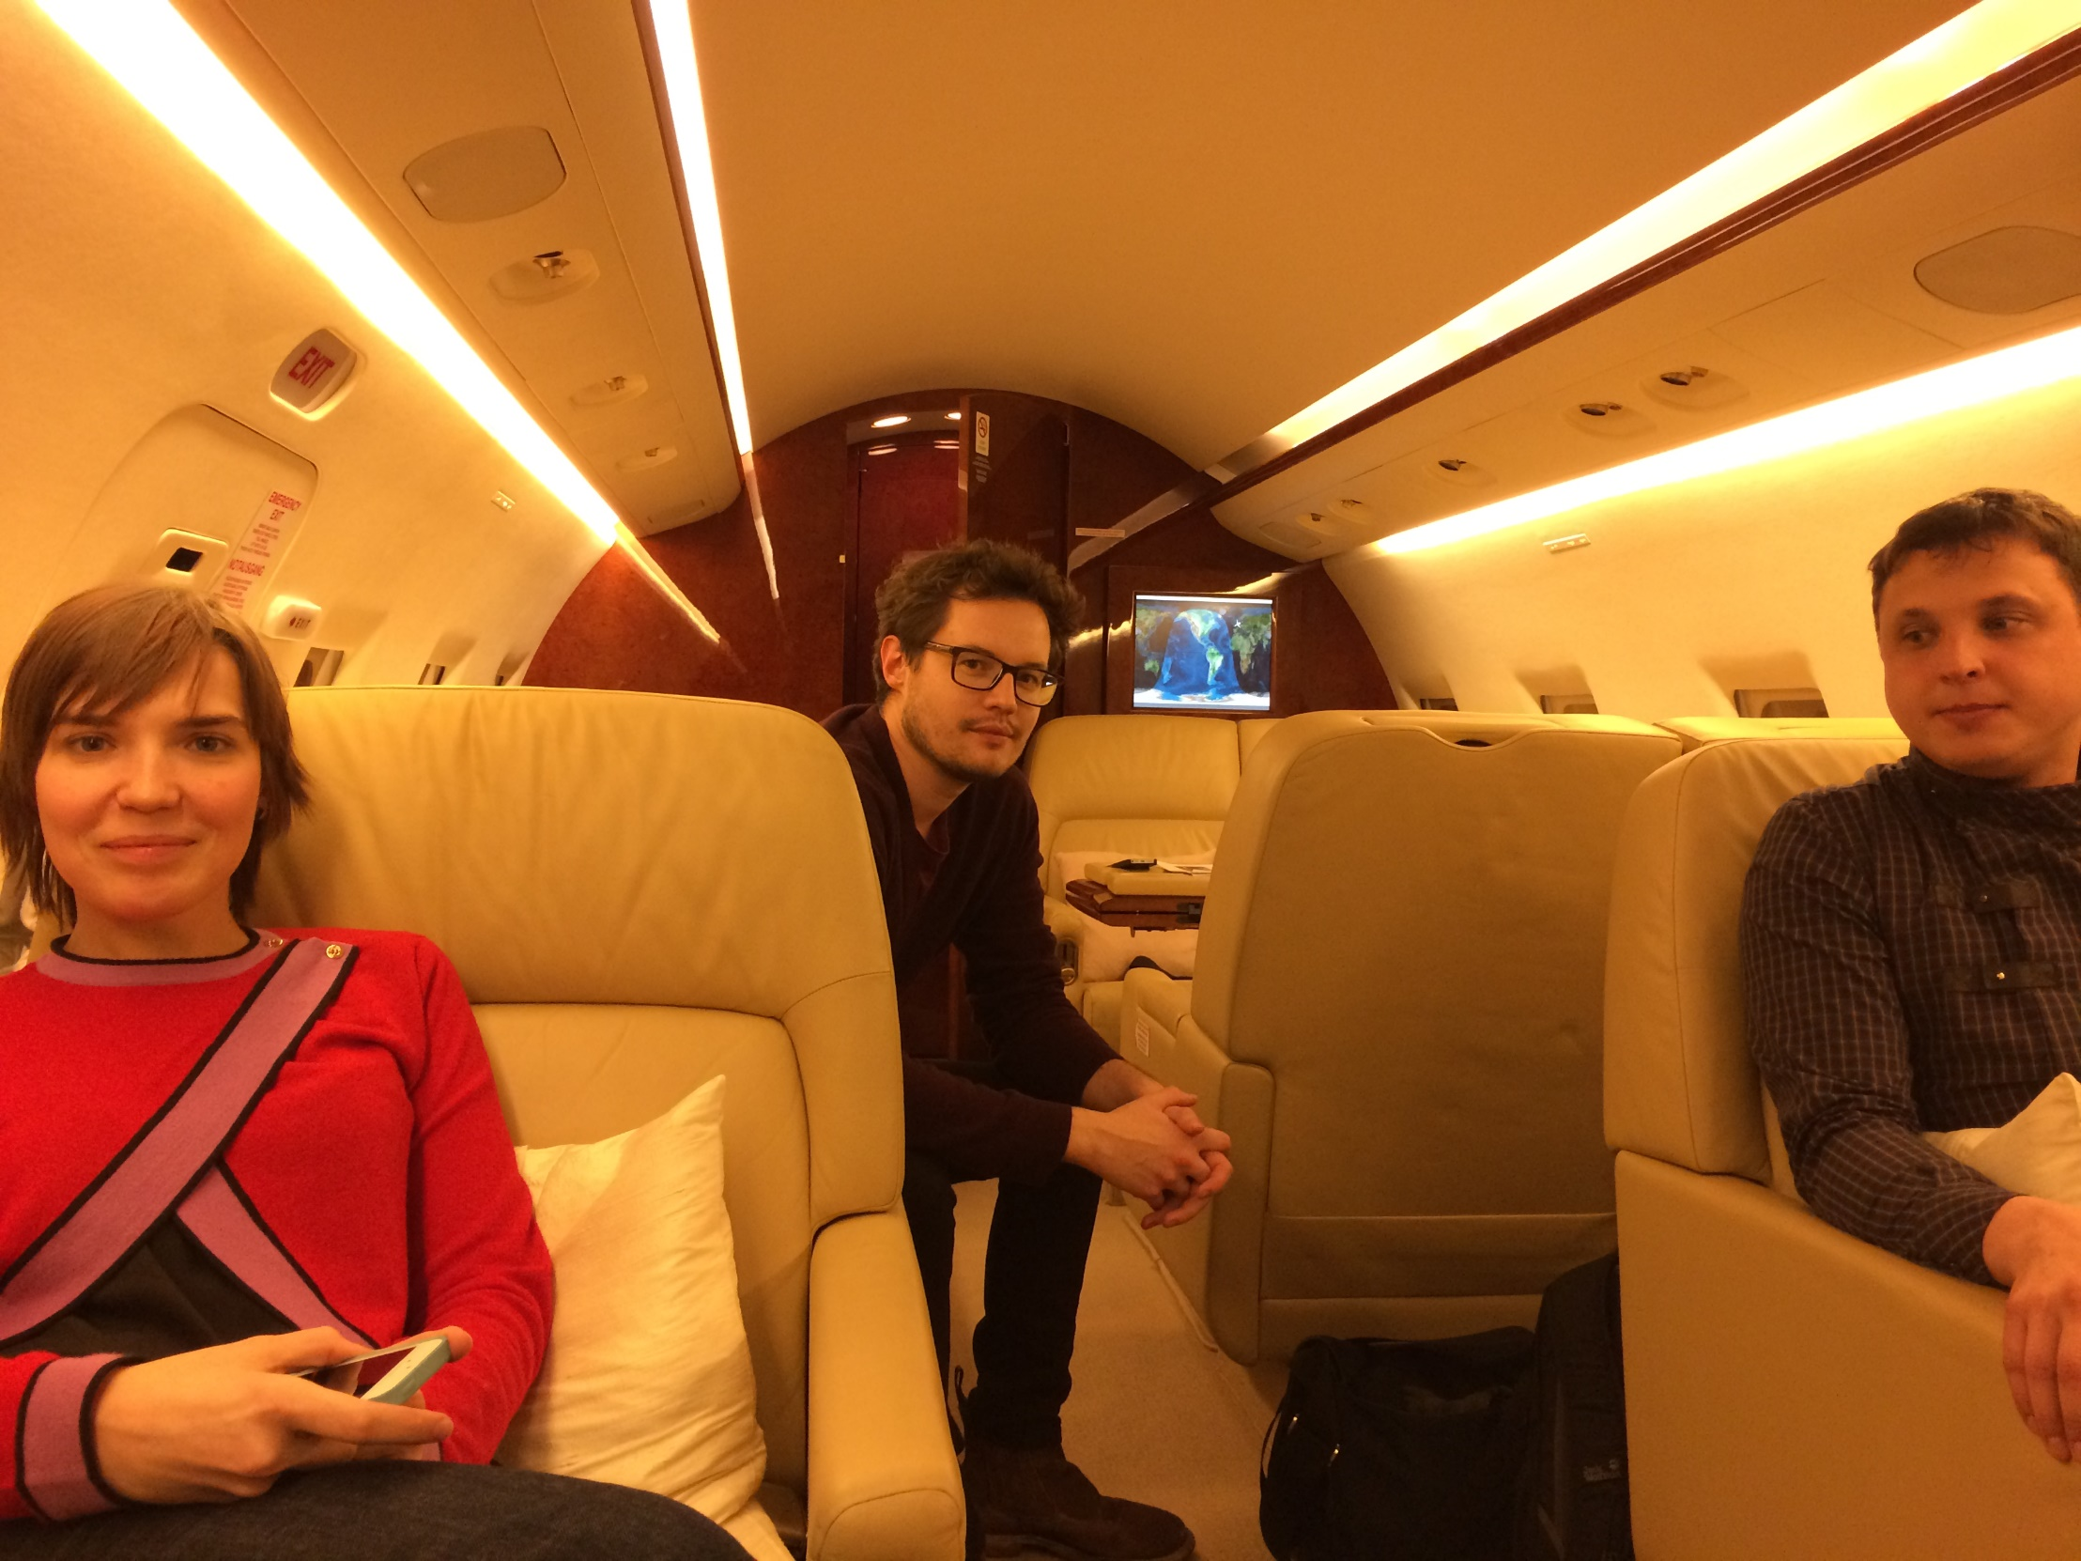

Slide 10
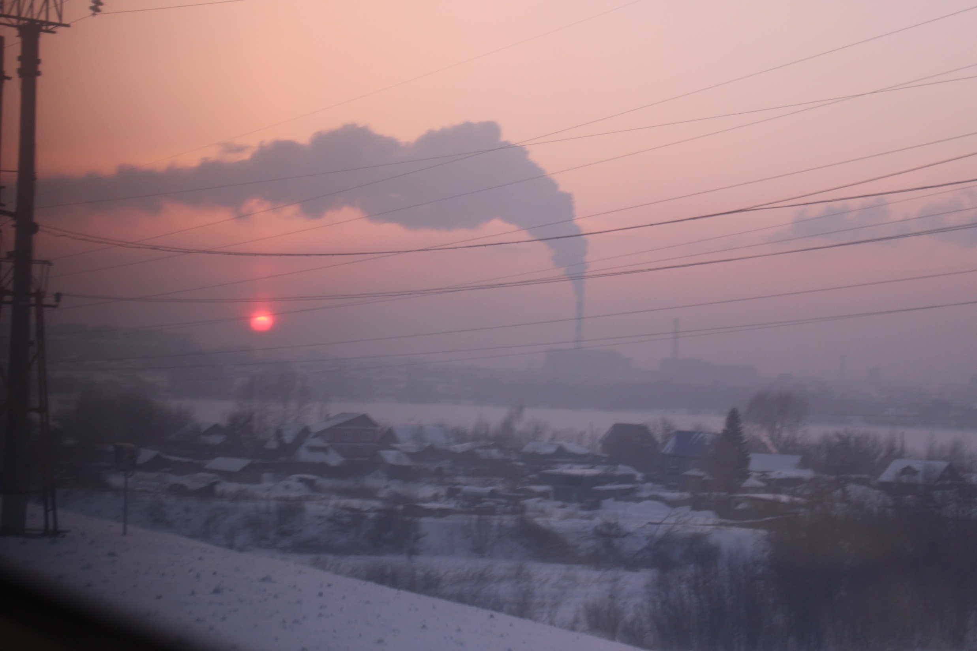

Slide 11
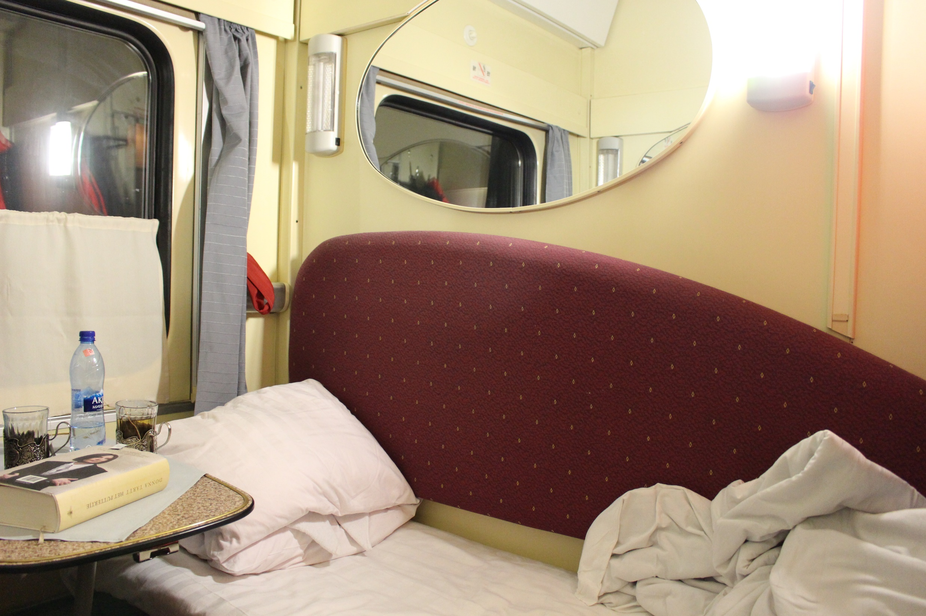

Slide 12
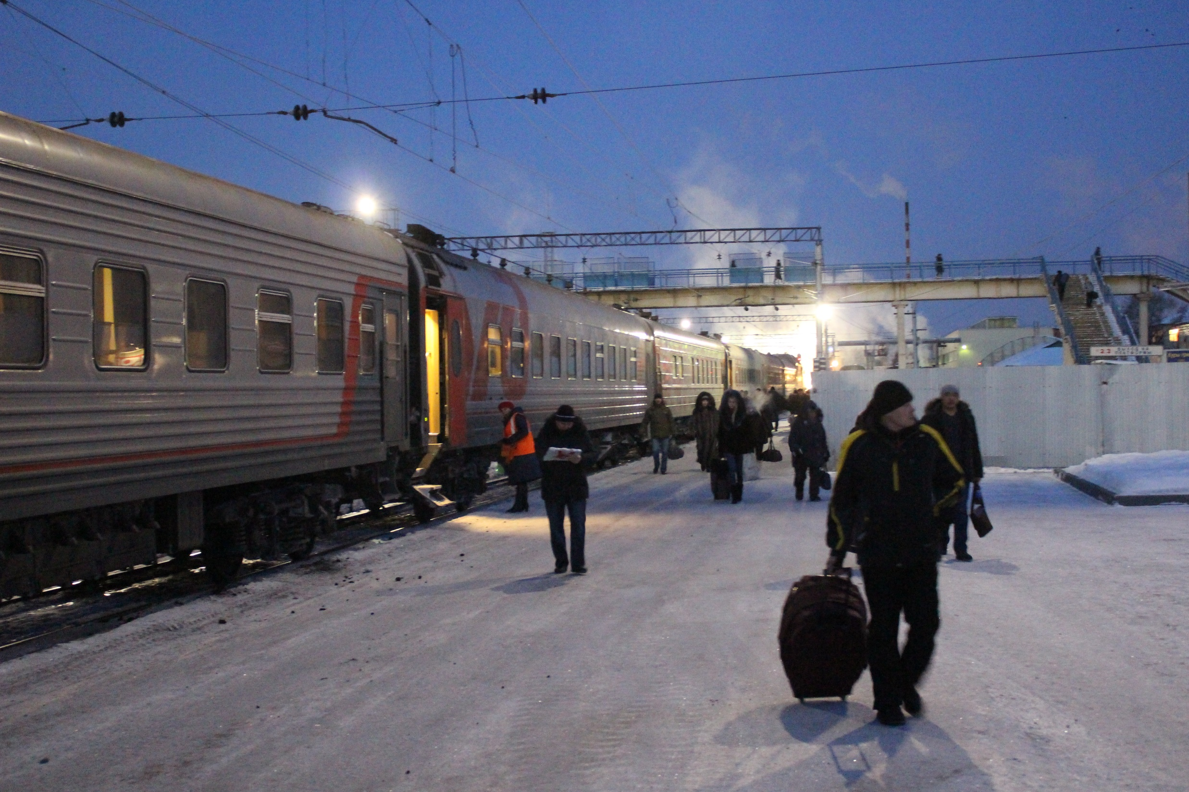

Slide 13
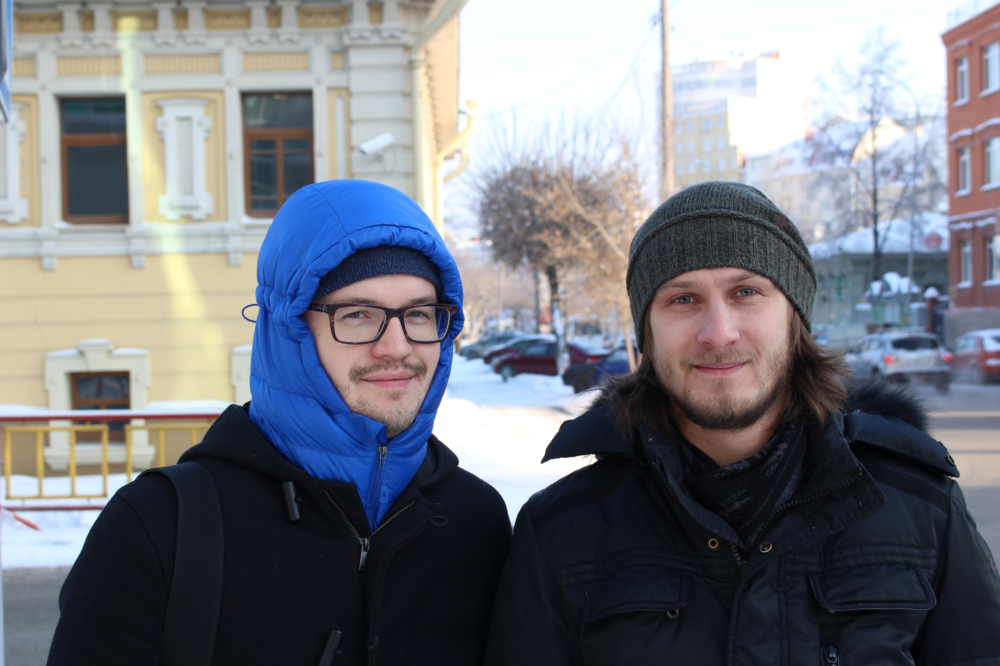

Slide 14
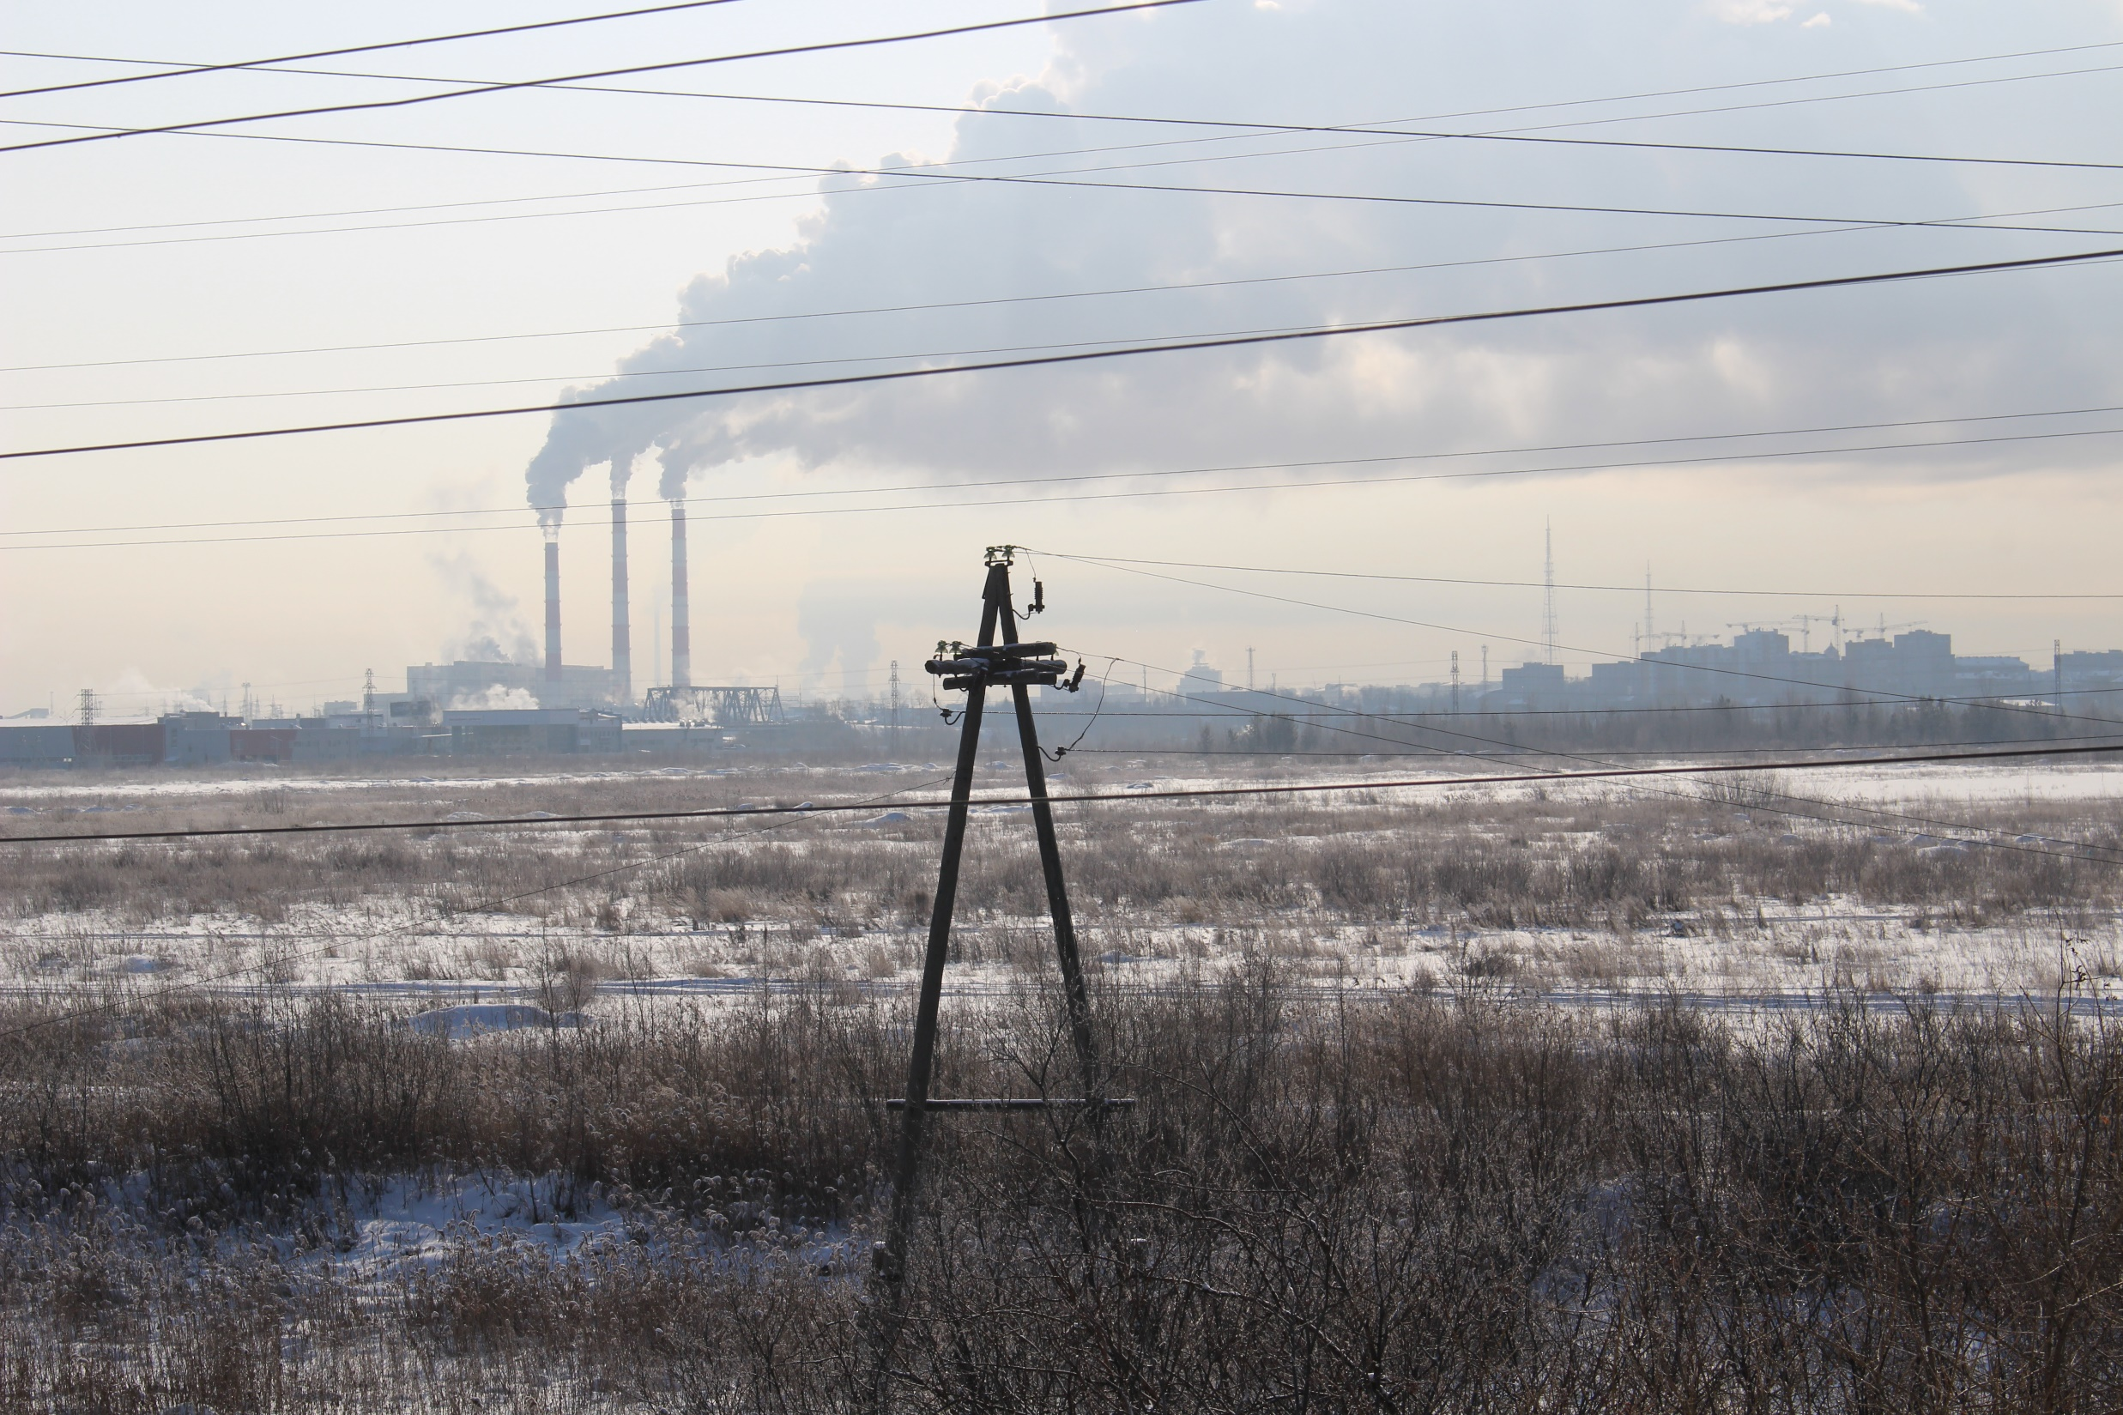

Slide 15
Back to Architecture and Planning
Centralities / Mass and Fabric

Slide 16
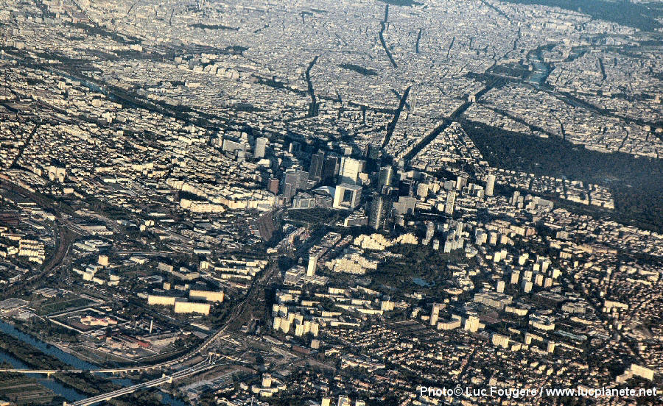

Slide 17
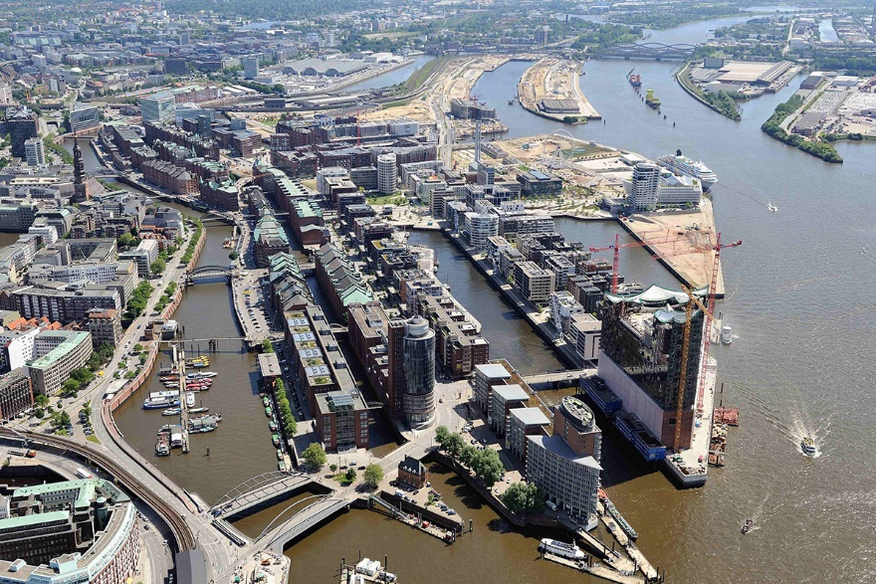
Hafencity Hamburg [GE]

Slide 18
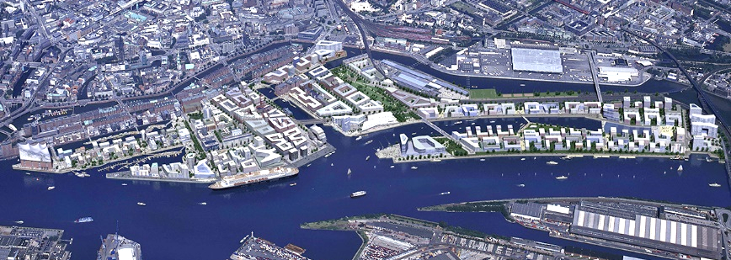
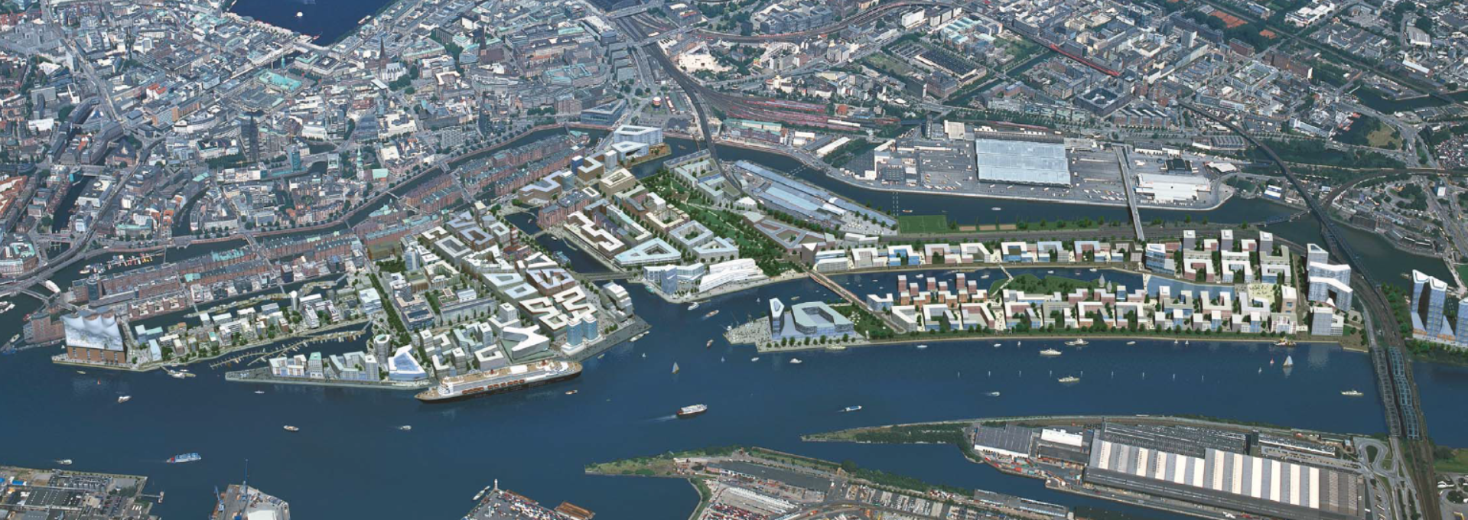
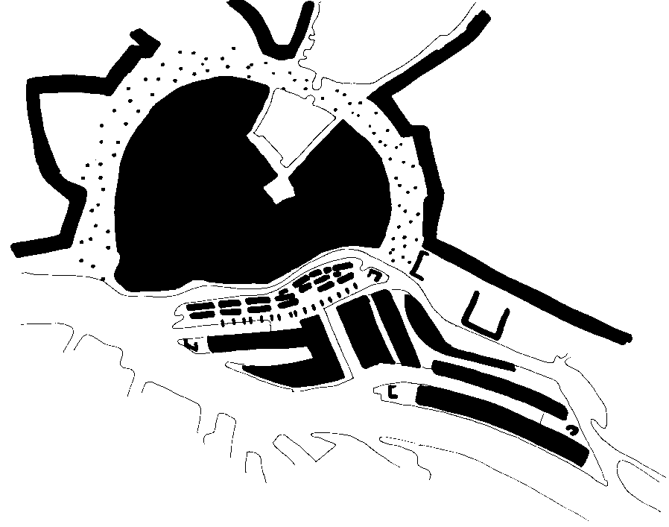
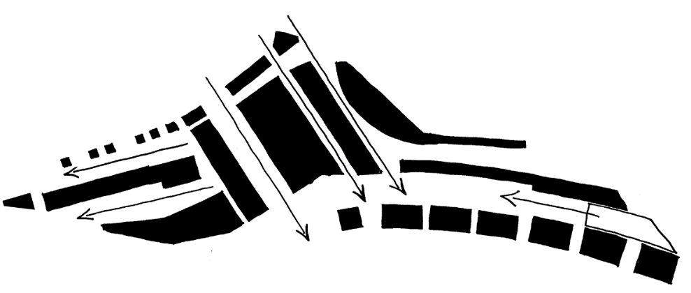
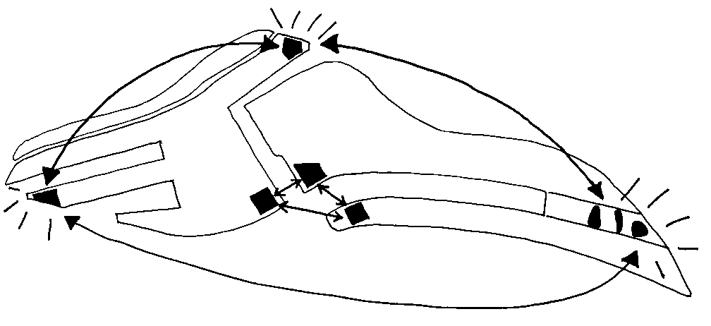
1 extend city center 40% 2 archipelago of quarters 3 Sites for specials

Slide 19
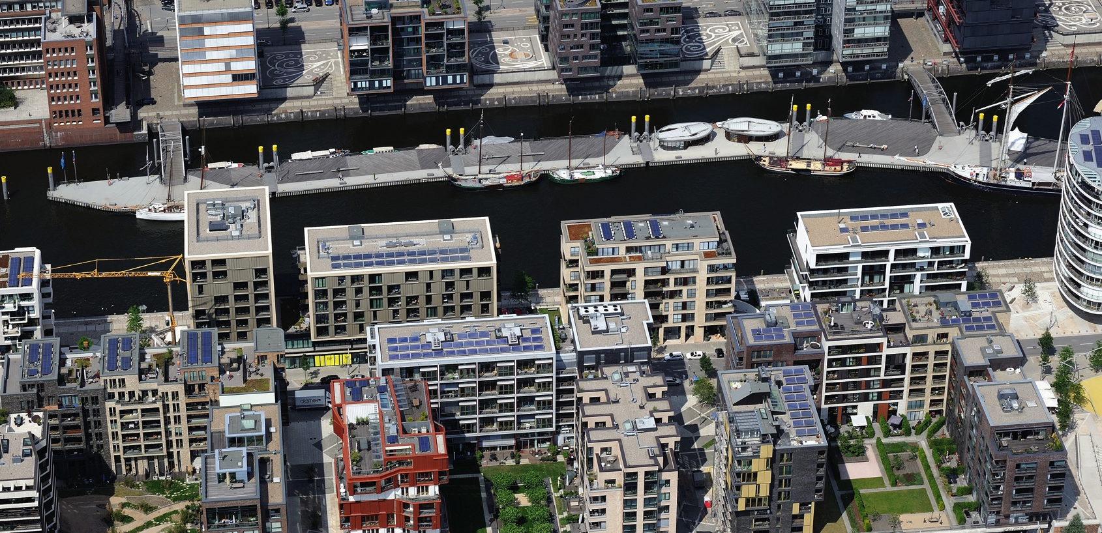

Slide 20
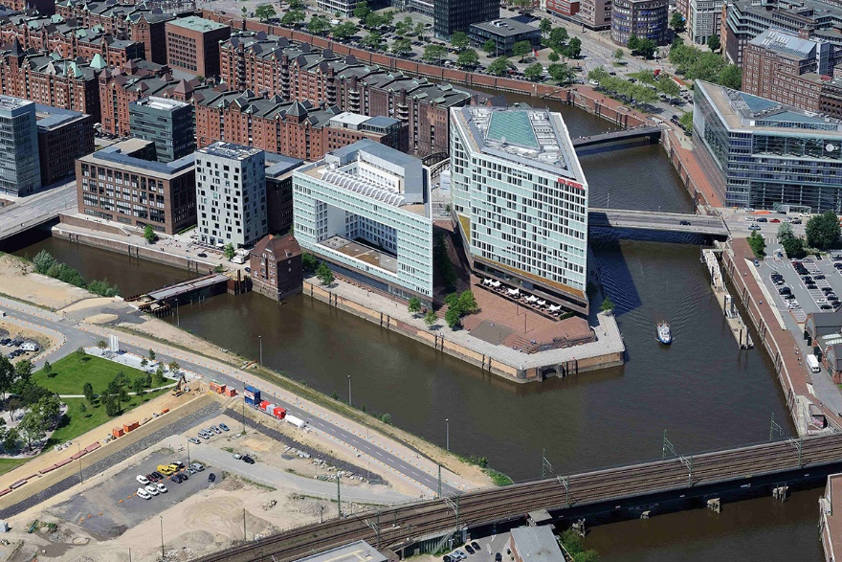

Slide 21
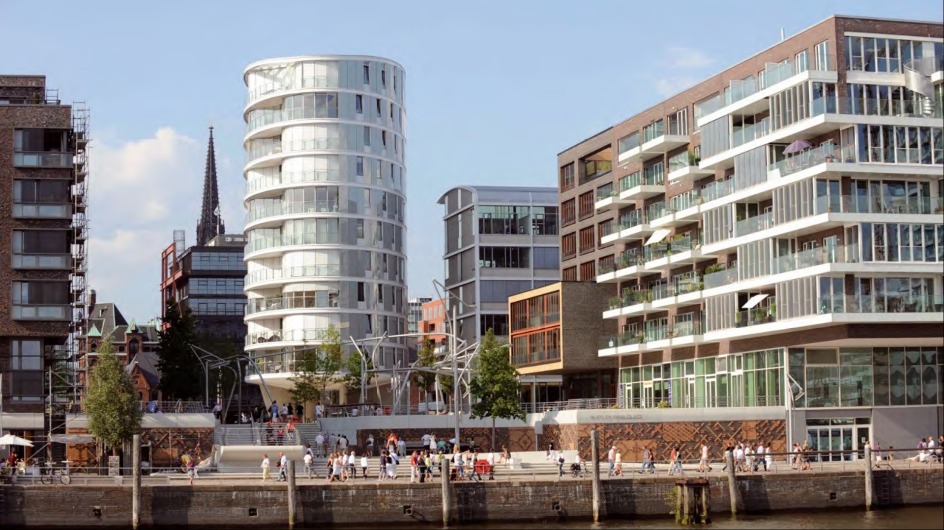

Slide 22
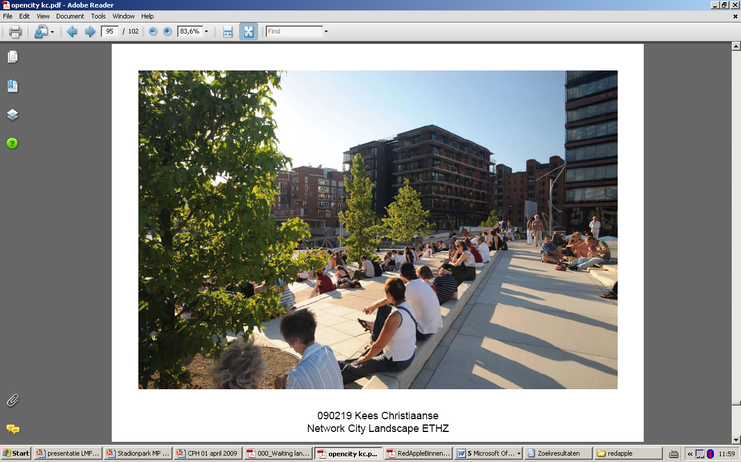
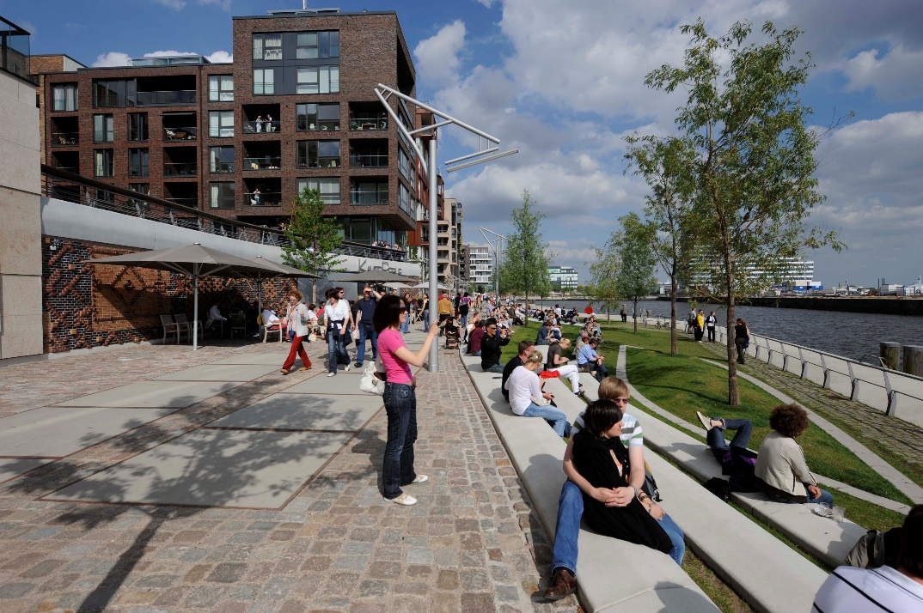
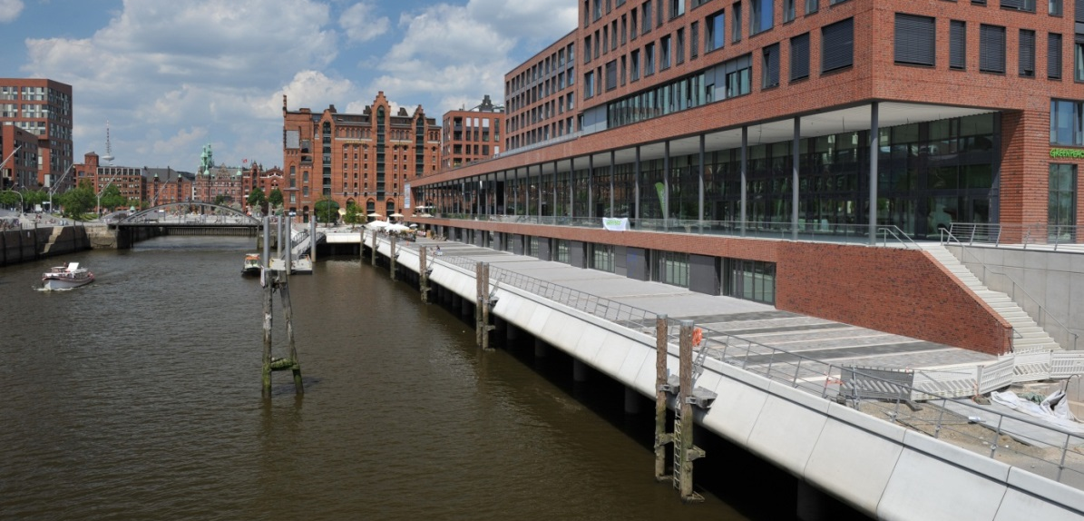
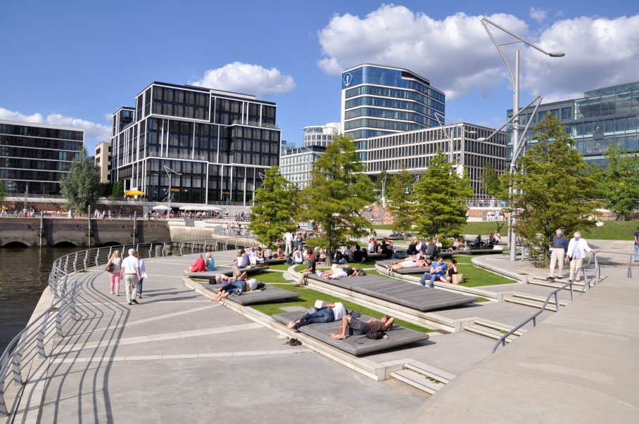
main dyke line

Slide 23
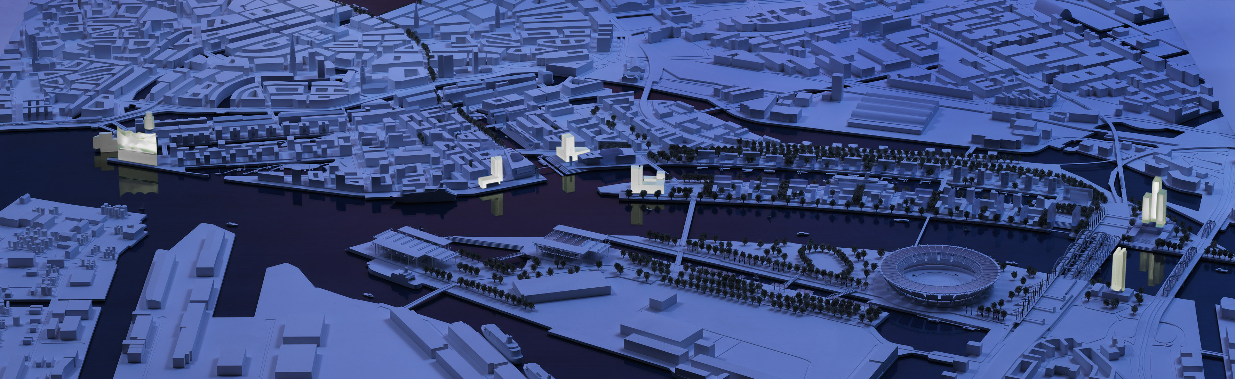

Slide 24
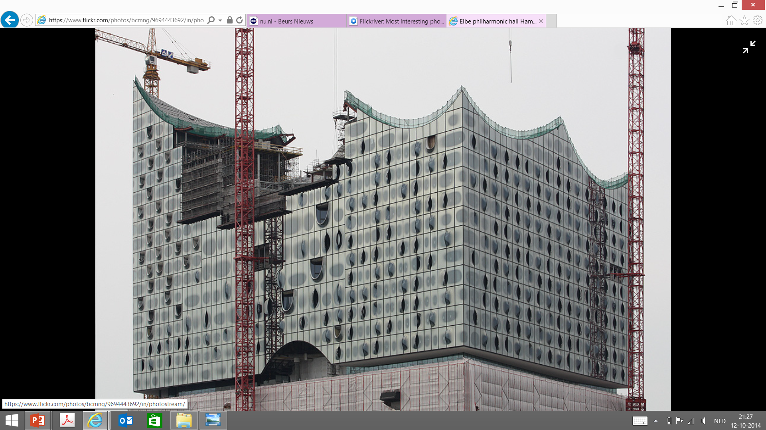

Slide 25
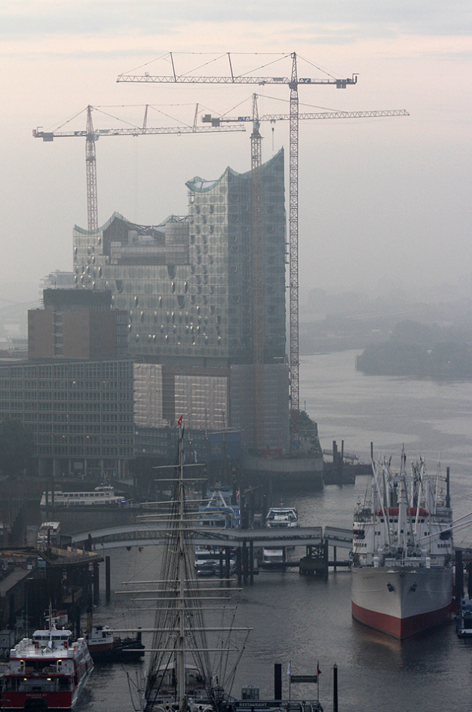

Slide 26
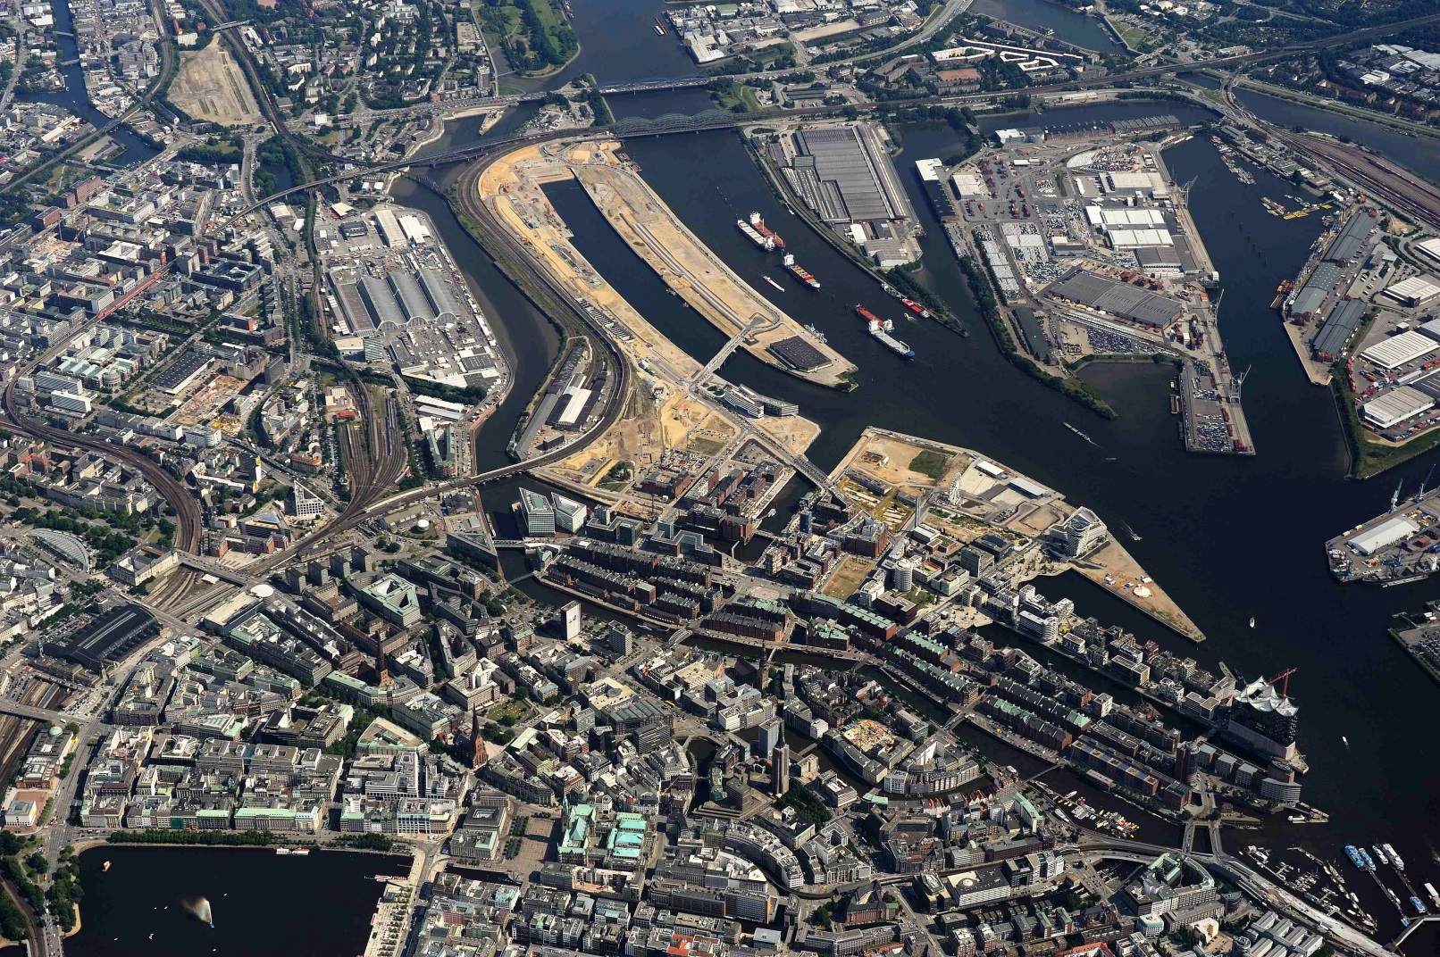
Masterplan for Hamburg Olympiade

Slide 27
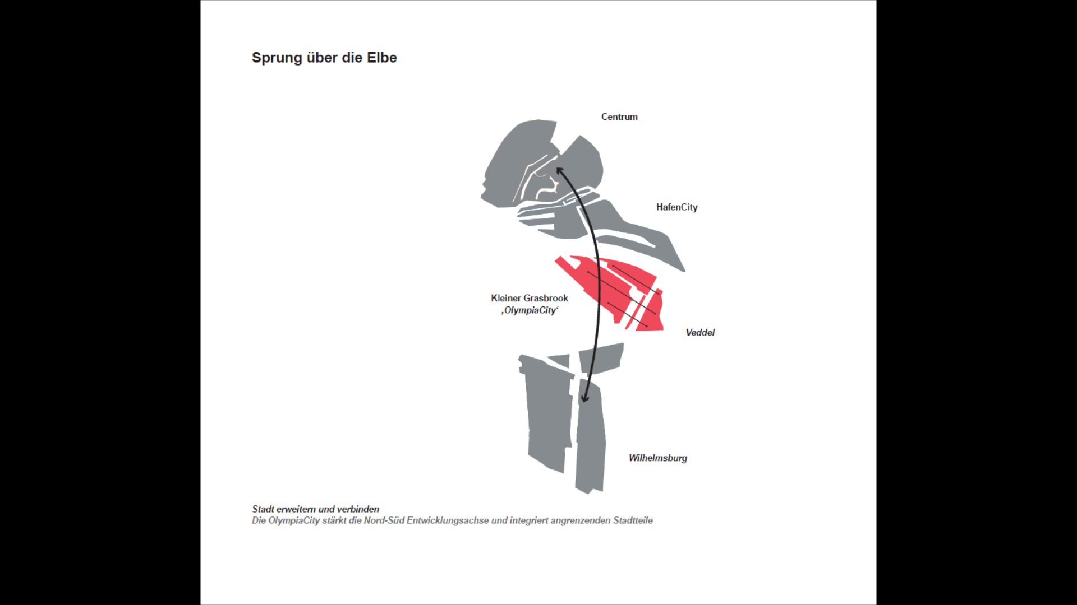
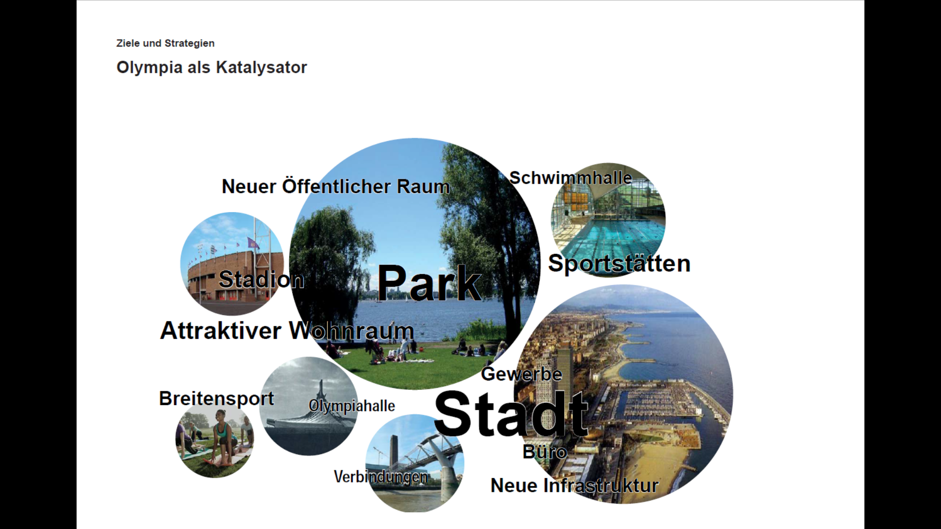

Slide 28
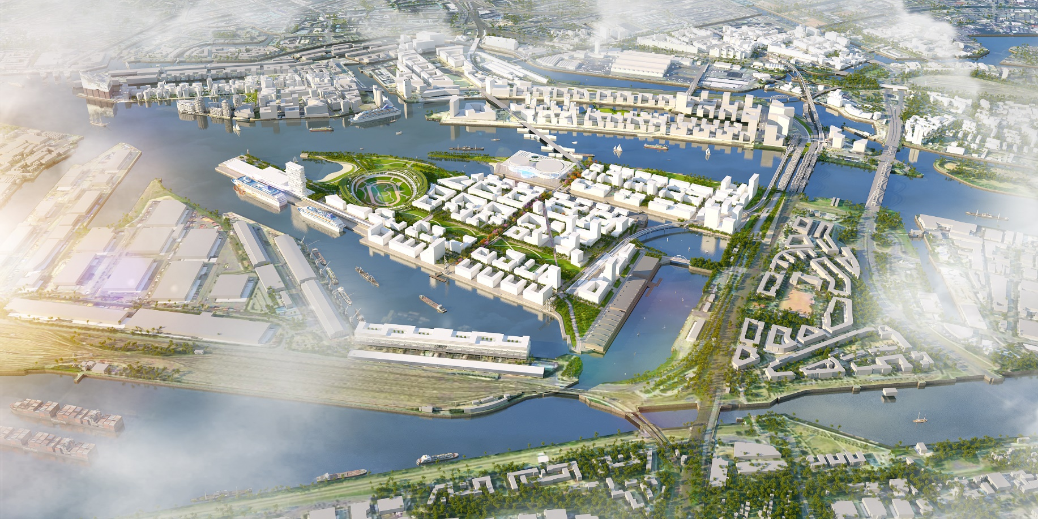

Slide 29
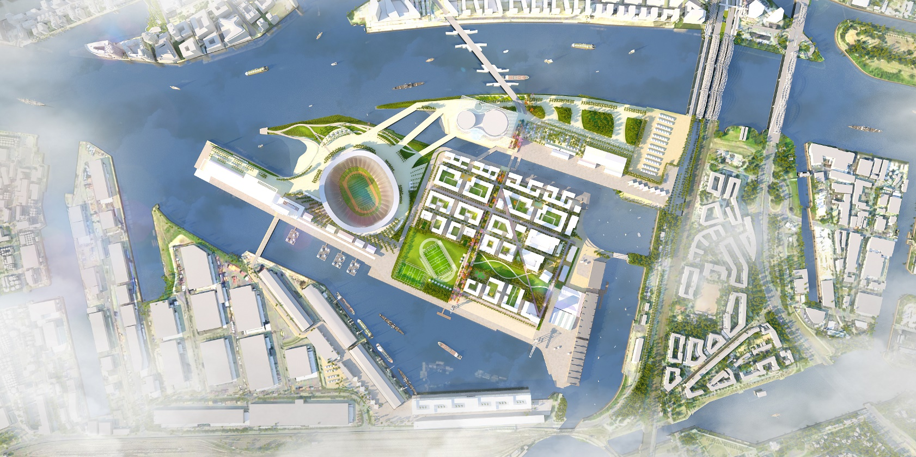
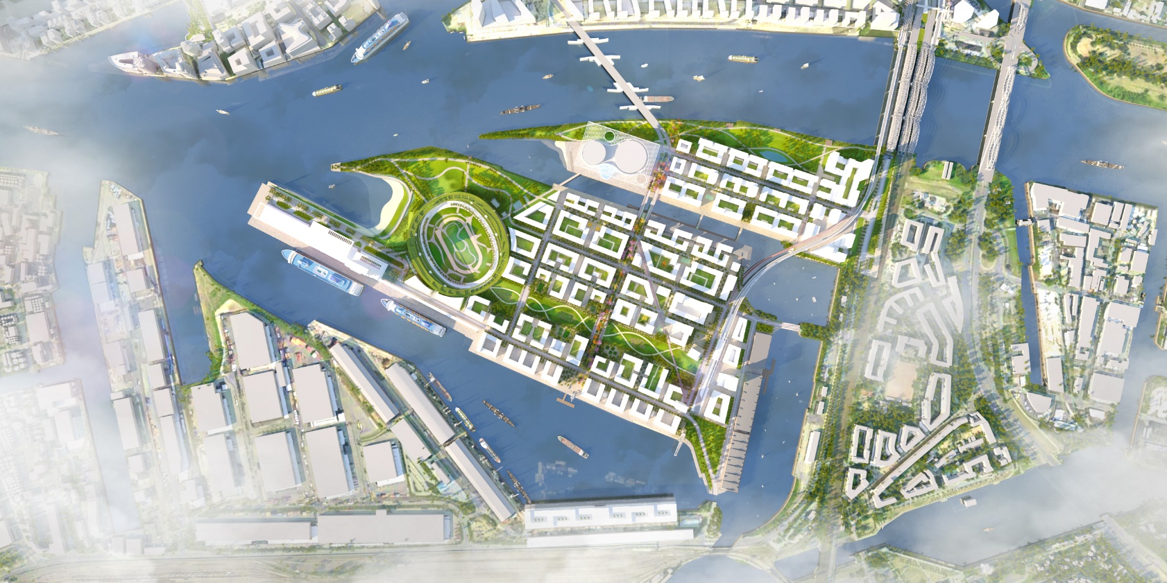

Slide 30
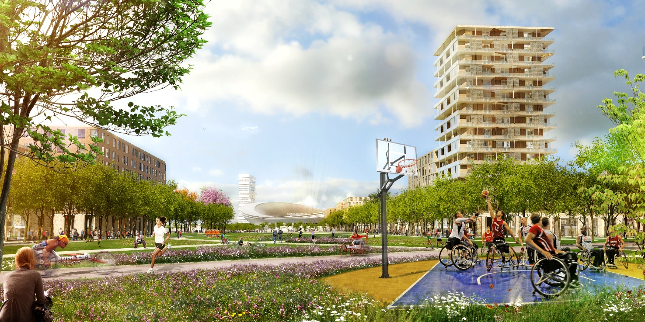
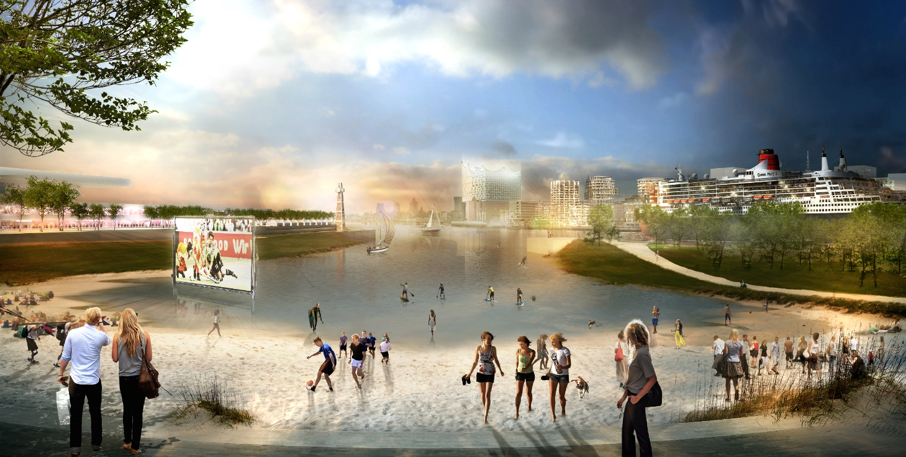
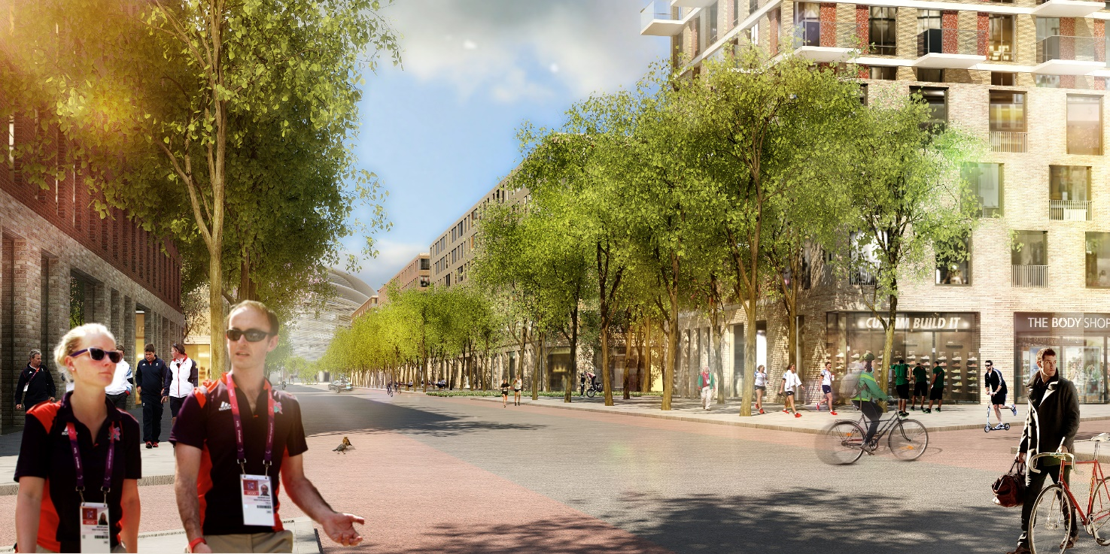
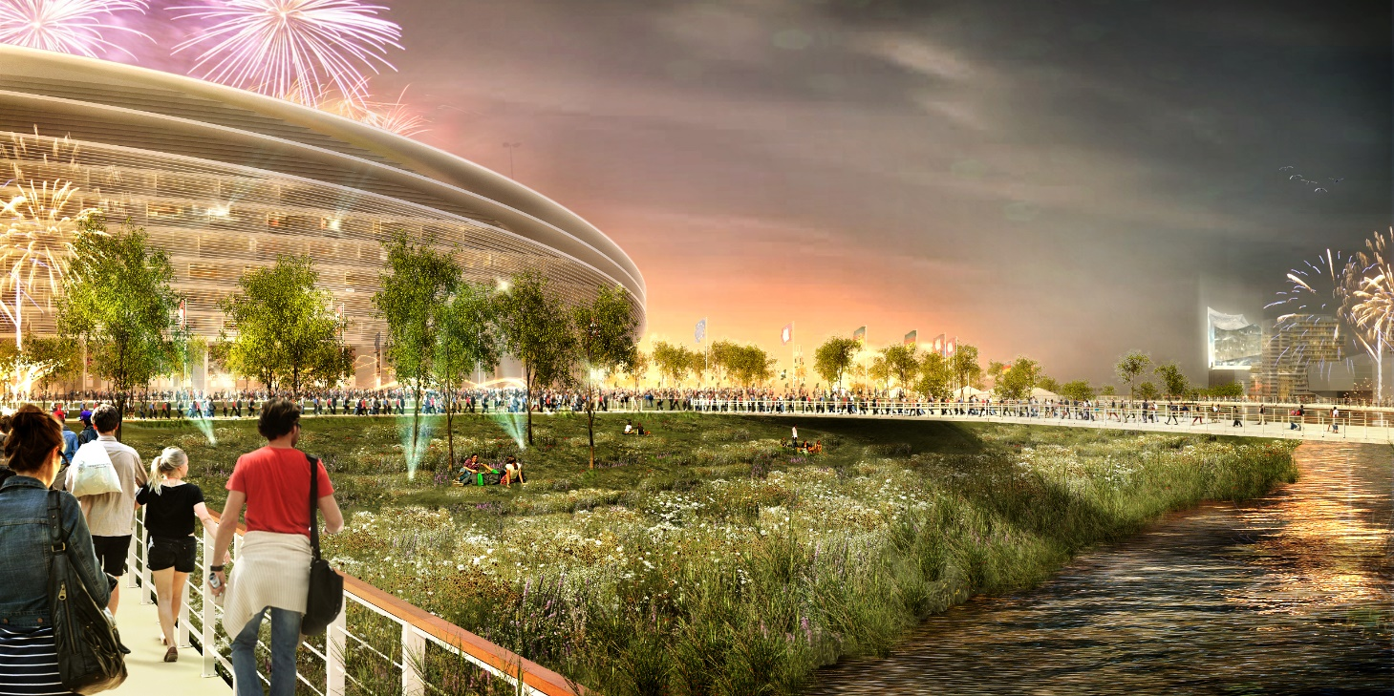

Slide 31
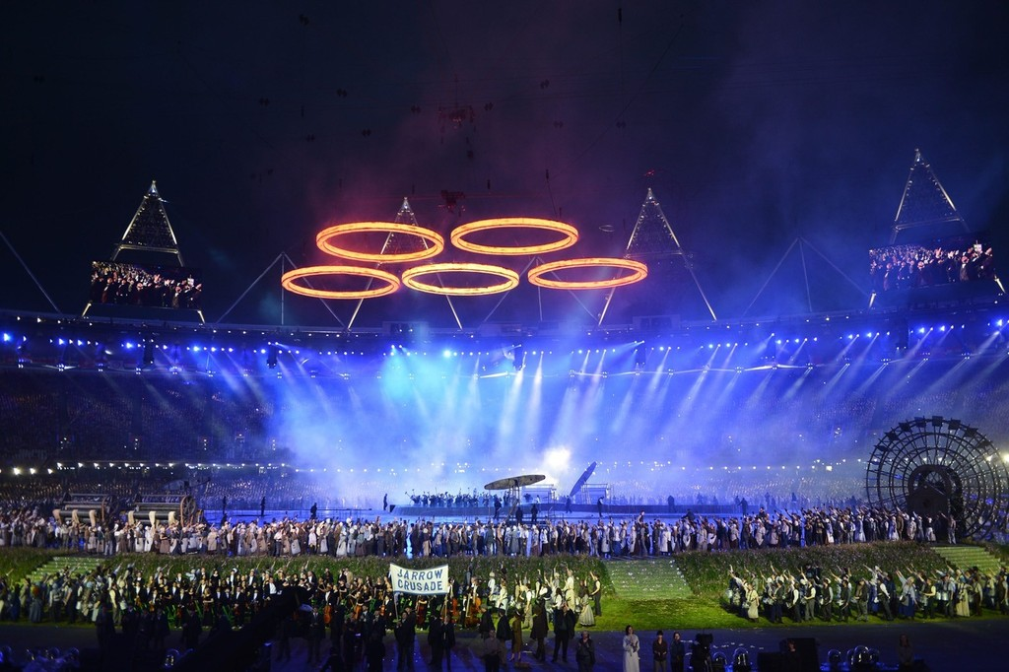

Slide 32
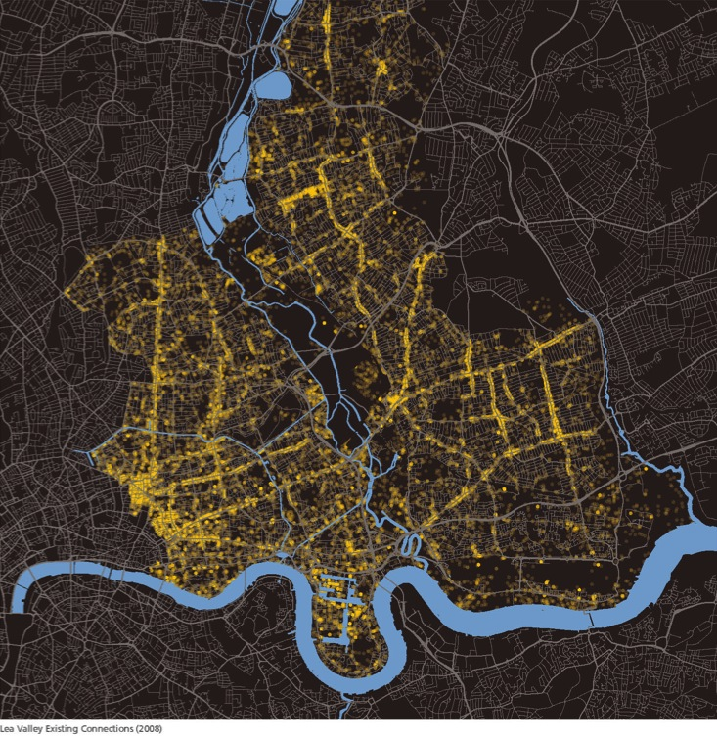
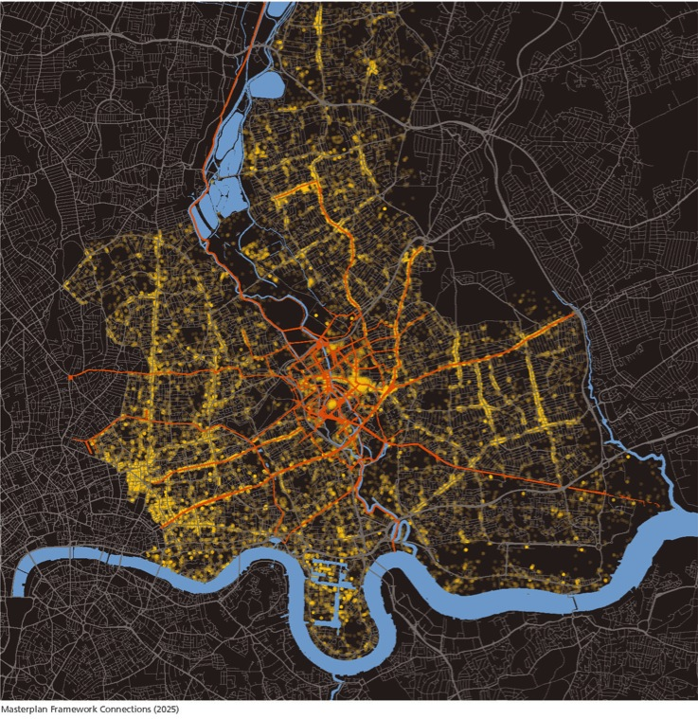
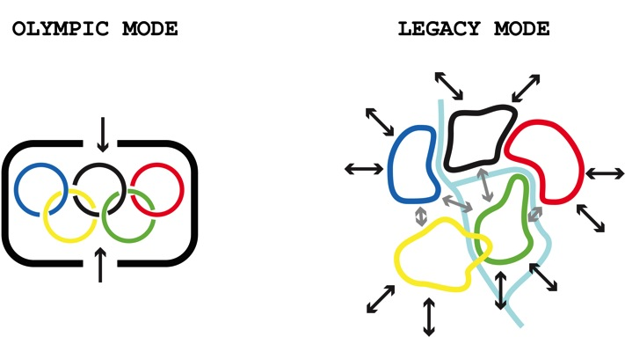
London Olympics legacy Master plan[UK]

Slide 33
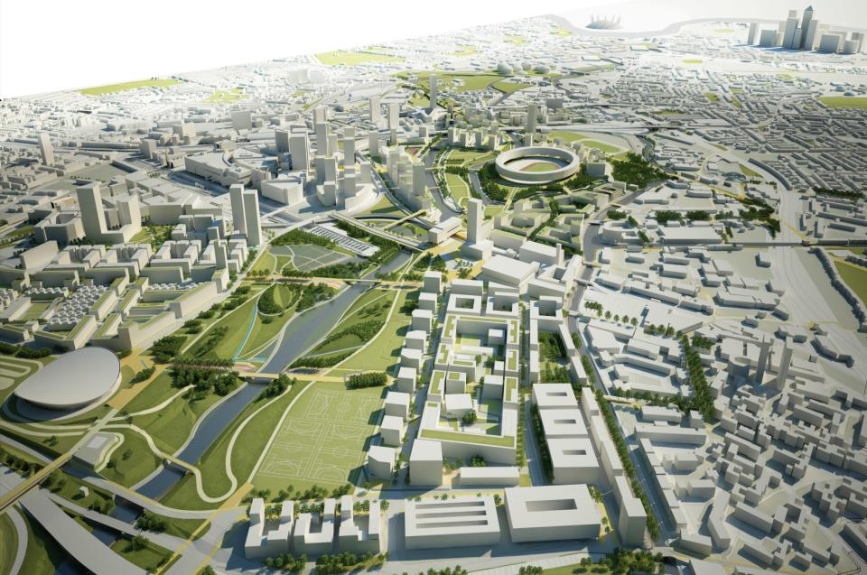

Slide 34
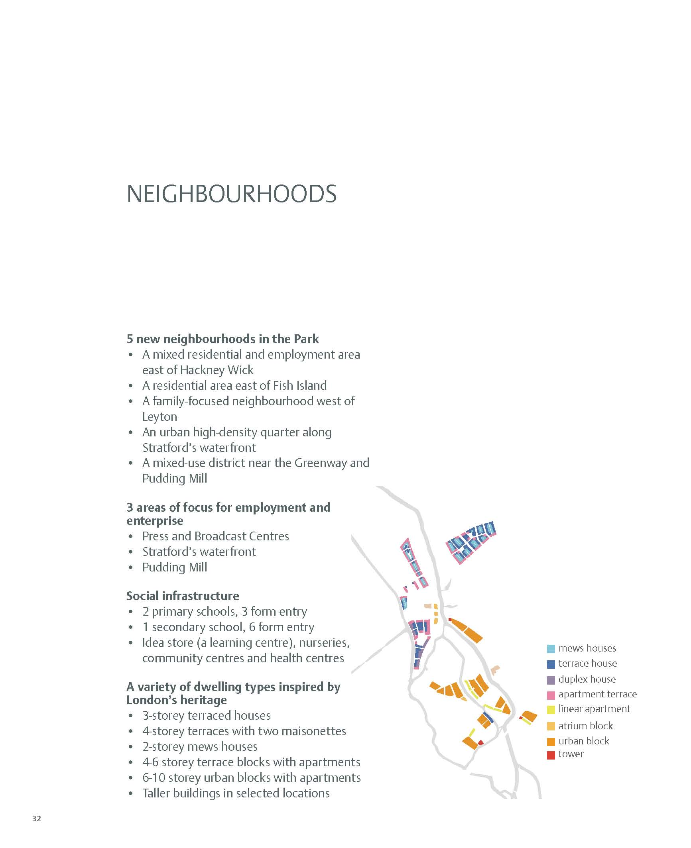
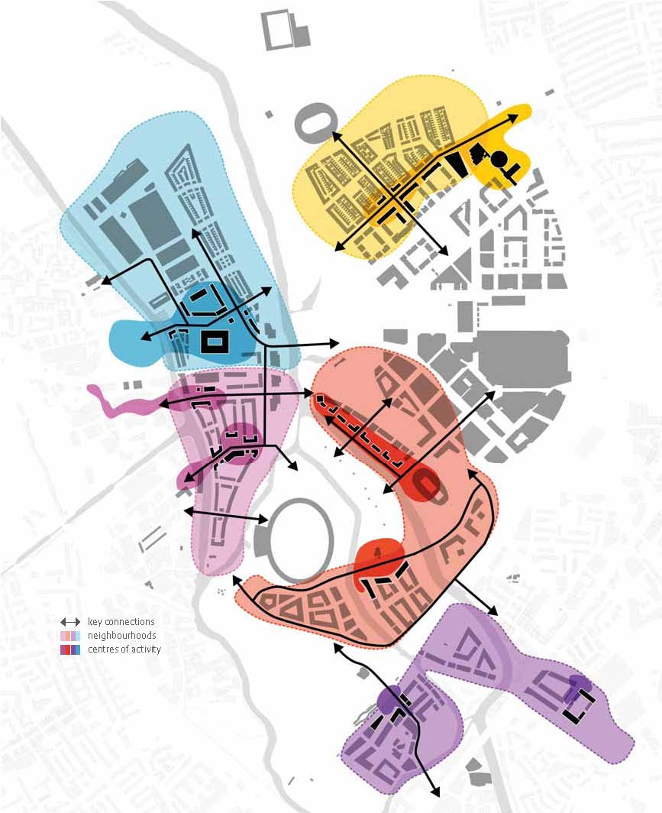

Slide 35



Slide 36


Slide 37

MOLZHANINOVO IN THE REGION

Slide 38

INCREASING GLOBAL HUB

Slide 39

POLYCENTRIC FUTURE

Slide 40

FINDINGS – HIGH POTENTIAL ECONOMIC SECTORS

Slide 41

PROPOSAL – PROGRAM MIX
14.000.000 m2 GFA
9.000.000 m2 NET

Slide 42

AMBITION DIAGRAM

Slide 43





Slide 44


IFCity
IFCity |Финальная презентация| 7 апреля 2014 |Консорциум KCAP || IFCity Final Presentation | 07th of April 2014 | KCAP Team

Slide 45
ЭКОСИСТЕМА IFCity
IFCity ECOSYSTEM
1-Я ОЧЕРЕДЬ
2-Я ОЧЕРЕДЬ
3-Я ОЧЕРЕДЬ
СХЕМА ОЧЕРЕДНОСТИ IFC
Phase 1
Phase 2
Phase 3
Phase 4
Islamic
Banks
Russian
Rating
Agency
Stock
Exchange
Finance
B School
Islamic
Banks
Sberbank
University
Exhibition
Hall
I
IFZ
Sberbank
Finance
B School
Conference
Centre
Int’l
schools
Int’l
Poly-
Clinic
Sberbank
Russian
Banks
School of
Finance
Bilingual
Daycare
Shopping
Centre
Russian
Banks
Sberbank
Russian
Banks
Russian Rating Agency
Leisure
Serviced
Apartmts
Global
Banks
Global Banks
Hotels
Housing
Serviced
Apartmts
Serviced
Apartmts
Global
Banks
Stock Exchange
F
Hotels
Hotels
Islamic Banks
Culture
Hotels
Sberbank
Serviced
Appartments
RU/CIS Banks
Public
Spaces
METRO
Shopping
Centre
METRO
Regulat.
Bodies
C
Shopping
Centre
METRO
Industry
Support
Central Bank
MinFin
SFZ
Consulting
Firms
Housing
Int‘l
Schools
Law
Firms
Regulatory
Bodies
Bilingual Court
Metro
Housing
IT
Firms
Start-ups
New
Tech
Firms
Public
Spaces
Public
Spaces
Poly-
Clinic
SKOLKOVO
Airports
Moscow
City
IFCity |Финальная презентация| 7 апреля 2014 |Консорциум KCAP || IFCity Final Presentation | 07th of April 2014 | KCAP Team

Slide 46

IFCity УНИКАЛЬНОЕ МЕСТО
IFCity UNIQUE PLACE
IFCity |Финальная презентация| 7 апреля 2014 |Консорциум KCAP || IFCity Final Presentation | 07th of April 2014 | KCAP Team

Slide 47

ЯДРО IFCity СО СТОРОНЫ НОВОРИЖСКОГО ШОССЕ
IFCity FROM NOVORIZHSKOYE HIGHWAY
IFCity |Финальная презентация| 7 апреля 2014 |Консорциум KCAP || IFCity Final Presentation | 07th of April 2014 | KCAP Team

Slide 48

ЦЕНТР ИСКУССТВА, БИЗНЕСА И КУЛЬТУРЫ
ABC CAMPUS
IFCity |Финальная презентация| 7 апреля 2014 |Консорциум KCAP || IFCity Final Presentation | 07th of April 2014 | KCAP Team

Slide 49

АКТИВНОЕ ЯДРО IFCity
LIVELY IFCity CORE
IFCity |Финальная презентация| 7 апреля 2014 |Консорциум KCAP || IFCity Final Presentation | 07th of April 2014 | KCAP Team

Slide 50

ЛАНДШАФТ
Northern River Park
LANDSCAPE
Venice Canals & Beach Park
IFC Marina & Riverwalk
Passage
Waterfront Park
Watercampus
Embankment Golf Course
Central Park
Arkhangelskoye Gardens
River Front Parks
Embankment Park with water reservoir
IFCity |Финальная презентация| 7 апреля 2014 |Консорциум KCAP || IFCity Final Presentation | 07th of April 2014 | KCAP Team

Slide 51

ГОРОДСКАЯ МОЗАИКА
URBAN MOSAIC
Northern Gateway
Western Gateway
Venice Lofts
The Wharf
Wall Street Quarter
Embankment Park Girth
Central Mixed City Quarter
Arkhangelskoe Gardens
Central Park District
Garden Blocks
South Garden District
IFCity |Финальная презентация| 7 апреля 2014 |Консорциум KCAP || IFCity Final Presentation | 07th of April 2014 | KCAP Team

Slide 52

IFCity |Финальная презентация| 7 апреля 2014 |Консорциум KCAP || IFCity Final Presentation | 07th of April 2014 | KCAP Team

Slide 53

IFCity |Финальная презентация| 7 апреля 2014 |Консорциум KCAP || IFCity Final Presentation | 07th of April 2014 | KCAP Team

Slide 54
Embankment Park
with water reservoir
South Garden District
Western Gateway
Arkhangelskoe Gardens
River Front Parks
Wall Street Quarter
Venice Canals
& Beach Park
Central Park District
Watercampus
Central Mixed City Quarter
Embankment Park Girth
Venice Lofts
Central Park
Passage
Garden Blocks
The Wharf
Northern
Gateway
Embankment Park Girth
Waterfront Park
Golf Course
IFCity
Northern Riverpark
IFC Marina & Riverwalk

Slide 55
Back to Architecture and Planning
Centralities / Mass and Fabric

Slide 56
SAFETY AND INCLUSION
SAFETY AND INCLUSION
SUSTAINABILITY
EASE OF MOVEMENT
SUSTAINABILITY
EASE OF MOVEMENT
GOOD STREETS
AND
SPACES
WELL
DESIGNED BUILDINGS
LEGIBILITY
LEGIBILITY
CHARACTER
CHARACTER
ADAPABILITY
ADAPABILITY
DESIGNING FOR FUTURE MAINTENANCE
DESIGNING FOR FUTURE MAINTENANCE
Draw the future, make fabric and buildings which fit in!

Slide 57


Slide 58

100526 Biennale Moscow
58

Slide 59

100526 Biennale Moscow
59

Slide 60

100526 Biennale Moscow
60

Slide 61

100526 Biennale Moscow
61

Slide 62

100526 Biennale Moscow
62

Slide 63





Slide 64


Slide 65


Slide 66


Slide 67


Slide 68


Slide 69


Slide 70


Slide 71


Slide 72


Slide 73


Slide 74


Slide 75


Slide 76


Slide 77


Slide 78


Slide 79


Slide 80

MEETING ALEXEI SLEEPING

Slide 81


Slide 82


Slide 83



Slide 85


Slide 86


